Slide 1

LEADERSHIP DEVELOPMENT: Assessing Impact
Wednesday February 6, 2013 2:00 pm EST

Slide 2
Webinar Troubleshooting
The call-in number is 1-800-273-7043
The attendee access code is 811509
Your Attendee ID can be found at the “INFO” tab
The Event password : leadership
If you are still having trouble with the phone or online aspects of this webinar, please contact Christine Downing in the text box, or
Email: cdowning @ aacn.nche.edu, OR
Call (202)463-6930 ext. 266
Trouble with WebEx System-- 1-866-229-3239

Slide 3
Quick Reminders
Reduce background noise
Silence your cell phone
Close your office door
To mute your line *6
Participation
Q/A and Chat on the right
Ask a question at anytime
Trouble with the system
1-866-229-3239
Info Tab for more details

Slide 4
Culture and Climate
Change in an organization calls for its leaders to recognize and balance both culture and climate.
Culture vs Climate, The Kennedy Group, Ltd.

Slide 5
Culture
Culture is “how we do things.”
Culture is more difficult to measure because it is traditionally not written down.
Culture can be divided into five components: values, beliefs, myths, traditions and norms.

Slide 6
Climate
Climate is “how it feels to work here.”
Climate can be measured with relative precision.
Climate is determined by leadership, organizational structure, historical forces, standards of accountability, standards of behavior, communication, rewards, trust, commitment, vision and strategies, organizational connectedness, and external environment.

Slide 7
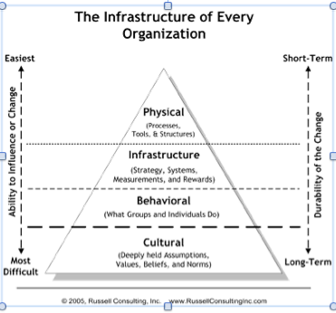
Organizational Infrastructure and Change

Slide 8
Leadership is Key
Leadership practices are the best way to affect the climate and thus, change the culture.
Leaders can mandate acceptable behaviors, not values.
Leaders can address lack of competencies.
Leaders can address unacceptable behaviors.
Leaders can use language to reinforce intent, reinforce behaviors and emphasize values.

Slide 9
QUESTIONS/ IDEAS AND SUGGESTIONS
Please submit questions in your chat window.

Slide 10
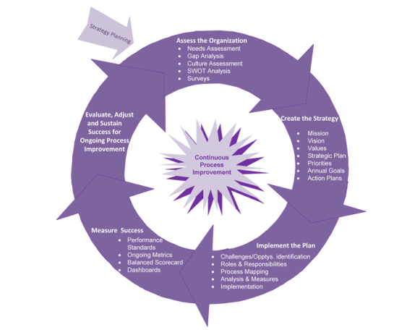
Leading Change

Slide 11
Conscious Change Efforts
  Assess the Organization
  Document the Culture and Assess the Climate
  Create the Strategy
  Implement the Plan
  Measure Your Success
  Evaluate, Adjust and Sustain Success
  Maintain a Culture of Continuous Improvement

Slide 12
Strategy for Cultural Change
Changing the basic assumptions and beliefs of the underlying cultural is very difficult.
Influence specific aspects of a culture that you want to change.
Target only those components that are most critical for implementing and sustaining the changes that concern you.
Galpin, T. Connecting Culture to Organizational Change (Human Resources Magazine, March 1996, pp. 84-90)

Slide 13
Target Cultural Components
Target one or more of the following components will help bring about change:
Rules and policies  Goals and measurements
Customs and norms  Training
Ceremonies and events  Management behaviors
Rewards and recognition  Communications
Physical environment  Organizational structure

Slide 14
Assessing Impact
Dr. Michael Relf—Duke University
What was different, if anything, regarding your approach in developing your Leadership Plan for 2012-2013?

Slide 15
Assessing Impact
Is the NCIN Leadership Development Tool Kit having an impact on your school’s climate and/or culture?

Slide 16
The Purpose of the Impact Assessment
The purpose of the Impact Assessment is to:
gain an understanding of the activities and/or changes you implemented
understand the impact of the changes on the school, the students, the faculty, and if applicable, the supporting systems, processes and technology
identify the areas which require more focus and effort to further influence the school’s climate and culture

Slide 17
The Format of the Impact Assessment
The format is a essentially a gap analysis:
Current State: What were the results of your organizational assessment – where did your school stand?
Future State: Where did you want your school to be with respect to the leadership development activities?
Gap: What activities did you plan to implement? What activities did you actually implement? What were the barriers to implementation if you did not implement them?

Slide 18
The Impact – What Changed?
Based on the activities you actually did to bridge the gap, what happened? Consider:
Did behaviors change – did faculty, staff or students do anything different?
Did language change – did faculty, staff or students change how they talked about things?
Did the way things were done change?
Did the atmosphere in the school or program change?
Did the number of people involved change?
Did jobs change?

Slide 19
Tell Us What Happened
Current State | Future State | What activities were actually implemented? | What happened as a result of those activities?

Slide 20
QUESTIONS/ IDEAS AND SUGGESTIONS
Please submit questions in your chat window.

Slide 21
Contact
Leadership Development Questions:
Vernell DeWitty
vdewitty@aacn.nche.edu
202-463-6930 extension 224
Jihanne Jeanty
jjeanty@aacn.nche.edu
202-463-6930 extension 257

Slide 22
Next NCIN Webinar
Topic: Retention of Diverse Students:
“Creating Inclusive Learning Environments”
Discussion of best approaches to create inclusive environments. Highlighted will be
methods, including the sorts of approaches institutions do with the best of intentions that
don't work, as well as methods that research has shown, do work.
Speaker: Paul Gorski, PhD
New Century College, George Mason University
Date and Time: March 20, 2013
2:00 PM EST
Registration Link: https://rwjf.webex.com/rwjf/onstage/g.php?t=a&d=574241014

Slide 23
NCIN Webinar Schedule
Topic | Facilitator | Date and Time
Leadership Development Plan Workshop | Becky Choi, JD, groupforward Kathy Hutchinson, PhD, Boston College Michael Relf, PhD, Duke University Ann Marie Mauro, PhD, New York University | February 6, 2013 2 P.M. EST
Retention of Diverse Students: “Creating Inclusive Learning Environments” | Paul Gorski, PhD New Century College, George Mason University | March 20, 2013 2 P.M. EST
Update on Mentoring: “Raising the Bar on Your NCIN Mentoring Program” | Lois Zachary, PhD Leadership Development Services | April 17, 2013 2 P.M. EST
Review of PIP On-Line— Outcomes and Recommendations | Becky Choi, JD, groupforward (rescheduled from 2.20.2013) | April 24, 2013 2 P.M. EST

