Slide 1

Grantees Orientation
Thursday, October 11, 2012

Slide 2
PURPOSE
Provide an opportunity for new grantees and persons new to NCIN to ask questions and clarify program and grantee expectations
Discuss role and responsibilities
- National Program Office (NPO)
- Grantees
- Scholarship Recipients

Slide 3
Program Overview
Collaboration between RWJF & AACN
Addresses several key needs in nursing:
    Need for more diversity in nursing
    Need for more funding for accelerated students
    Need for highly educated entry-level nurses
Introducing the New Careers in Nursing
    Need to increase the pipeline of future faculty
Notes:
The Robert Wood Johnson New Careers in Nursing Scholarship Program is a collaboration between RWJF and AACN. The program is wholly funded by the Foundation and AACN conducts the operations of the program.

Slide 4
Program Staff
David Krol, MD, MPH, FAAP
RWJF Program Officer
Geraldine (Polly) Bednash, PhD, RN, FAAN
Chief Executive Officer, AACN
Program Director, New Careers in Nursing
Vernell DeWitty, PhD, RN
Program Deputy Director, New Careers in Nursing
Alexa Tehansky, BA
Program Coordinator, New Careers in Nursing
Christine Downing, MS
Research Assistant, New Careers in Nursing
Jihanne Jeanty, BA
Program Assistant, New Careers in Nursing
Notes:
The Staff of New Careers in Nursing are:

Slide 5
COMMUNICATIONS PARTNER
PR Solutions
Lisa Lederer – lisa@prsolutionsdc.com
Gretchen Wright – gretchen@prsolutionsdc.com
Molly Tomlinson – molly@prsolutionsdc.com
Telephone-- (202) 371-1999

Slide 6
National Program Office
Liaison to the Foundation
Provide technical assistance as needed
Facilitate communications and media contact (PR Solutions)
Disseminate program results/outcomes
Resolve difficulties or obstacles
Sponsor meeting and web based conferences
Notes:
The responsibilities of the National Program Office are ::

Slide 7
2008-2013

Slide 8
Program Growth 2008-2013
119 Schools of Nursing
41 States
2,717 Scholarship Recipients
2008-2012 Scholars
    1557 (67%)Graduates
    545 (24%)Progressing on schedule
    56 (2%)Delayed progression
    140 (6%)Withdrew from programs
Notes:
To date these are the results of the NCIN program.

Slide 9
SCHOLARSHIPS AWARDED TO DATE
 | 2008-2009 | 2009-2010 | 2010 - 2011 | 2011 - 2012 | 2012 - 2013
Applicants | 113 | 103 | 124 | 116 | 116
Funds Requested | $13,530,000 | $18,850,000 | $21,690,000 | $19,410,000 | $19,270,000
Schools Funded | 58 | 52 | 63 | 52 | 55
Scholarships Funded | 706 | 700 | 511 | 400 | 400
Scholarships Awarded | 695 | 700 | 511 | 327* | TBD
*Not all scholarship awarded to date
Notes:
To date 197 unique nursing schools (NS) from 43 states have applied for NCIN
grants.
• A total of 572 applications have been received for all five rounds
combined, (Round 1 = 113 applications, Round 2 = 103 applications and
Round 3 = 124 applications, Round 4 = 116, Round 5 = 116.)
• Total funding requests for all four rounds was $95,030,000, representing
9,503 scholarship requests.
• With the approval of Round 5 recommendations a total of 2,717
scholarships will have been approved for funding. (Round 1 = 706, Round
2 = 700 and Round 3 = 511, Round 4 = 400, Round 5 = 400).

Slide 10
Grantees by Program Type
Notes:
For the 2012-2013 grant period, the distribution of grants to the 55 schools were as follows:

Slide 11
Grantee Requirements
Expand enrollment by successfully recruiting and enrolling diverse students in entry-level accelerated nursing programs.
- Execute your stated plans for recruitment and retention of a diverse student body.
Leverage the expansion of faculty resources for these professional nursing programs.
- Demonstrate leverage of scholarships to sustain the expanded enrollment.
Notes:
These grantee requirements as presented in you letters of agreement are as followed. They are consistent with the applications submitted at the time of funding request.

Slide 12
Grantee Responsibilities
Demonstrate capacity to develop and support:
- Mentorship: facilitate student retention and rapid career progression.
- Leadership: support successful entry into the profession; monitor the progression of students through the program.
Evaluation of program based on self-determined criteria to measure impact and outcomes of scholarship funds.

Slide 13
Program Requirements
Pre-Entry Immersion
Test Success
Time Management
Mentoring
Mentoring Requirements
Mentoring Process
Leadership Development
Organizational Assessment
Learning Modules

Slide 14

Recruitment: Sustaining a Diverse Student Enrollment

Slide 15
Scholarship Recipient Selection
are from groups underrepresented in nursing or who are economically disadvantaged as defined herein;
are U.S. citizens, resident non-citizen nationals or resident foreign nationals;
have been accepted in an accelerated nursing degree program;
complete a letter of commitment to the NCIN program; and
are committed to pursuing professional nursing licensure through the National Council Licensure Examination for Registered Nurses (NCLEX-RN®).
Notes:
One issue that we frequently address is related to “disadvantaged students”. Our definition of disadvantaged is related only to being financially disadvantaged. We use the HRSA definition that you will see on the next slide.
A word of caution, we do not expect that all your scholarships will be awarded to persons who are financially disadvantaged, without any scholars of ethnic/racial or gender diversity. Our primary objective is to increase the number of persons underrepresented in nursing.
While schools of nursing make the final decisions on which student will receive an award, we are attentive to how these awards are made and monitor your adherence to what was outlined in your proposal.
Additionally, should you return for more rounds of funding, we review past performance.

Slide 16
Underrepresented Minorities
As defined by the Health Resources and Services Administration (HRSA) of the U.S. Department of Health and Human Services (HHS),”underrepresented minorities” are racial and ethnic populations who are underrepresented in the registered nurse population relative to the percentage of that racial or ethnic group in the total population. This would include Black or African American, Hispanic or Latino, American Indian or Alaska Native, and any Asian or Pacific Islander group other than Chinese, Filipino, Japanese, Korean, Asian Indian, or Thai. According to National Sample Survey of registered nurses, males also are underrepresented in the registered nurse population relative to their number in the total population.

Slide 17
Economically Disadvantaged
As defined by HRSA, an “economically disadvantaged” person comes from a “low income family,” meaning a family with an annual income that does not exceed 200 percent of HHS’s poverty guidelines; a family is a group of two or more individuals related by birth, marriage or adoption who live together, or an individual who is not living with any relatives.

Slide 18
Pre-Entry Immersion Toolkit
Notes:
Retention is one area where we are making a significant change this year. Even though we have an extremely low attrition rate, we receive info from students (even the successful ones) if what they wish they had known before their programs were started. Consistently students say to us, we just did not know what to expect, how fast the pace would be, how different it is taking nursing tests.
Therefore, we made a decision to support both you our grantees and our scholarships to address this issues through a pre-entry immersion program. Some of our applicants already a similar type of program and we have engaged several of these programs to work with us on the project.

Slide 19
Pre-entry Immersion Program
Program Template
    Customized for each site
Financial support for each program
Must occur before students begin the program
Scholars required to participate
Outcomes:
    Mentoring Program Initiated
    Leadership Plan Submitted
    Program Evaluation
    Scholars complete Entry Survey
Notes:
An overview of this program is as follows:

Slide 20


Slide 21
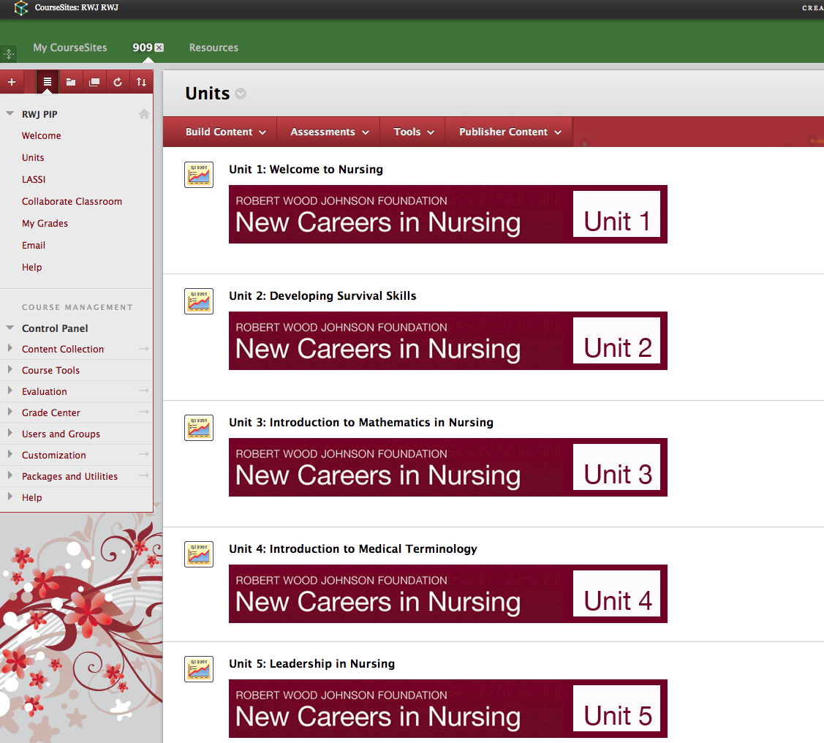

Slide 22


Mentoring
Released May 2011
Revised Fall 2012
http://www.newcareersinnursing.org/resources/mentoring-toolkit-and-handbook

Slide 23
Leadership Development

Slide 24
LEADERSHIP PLAN
The Journey from Nursing Student to Nursing Leader Page 61
Thursday September 15, 2011 12:30-1:00 p.m. | Carol Moore | 1. Knowing Your Path: Leadership Goal Setting Exercise (Short/Regular Format) | P age 63/65
Monday September 19, 2011 12:30-1:30 p.m. | Linda Quinn | 2. Knowing Yourself: Leadership Experience and Integration Exercise (Short/Regular Format) | Page 71/74
Wednesday November 2, 2011 12:30-1:30 p.m. | Erika Pritchard | 3. Inspiring a Shared Vision: Can You See It? Exercise | Page 88
Wednesday November 16, 2011 12:30-1:10 p.m. | Erika Pritchard | 4. Enabling Others to Act: Exploring Differences | Page 103
Wednesday November 16, 2011 1:10 – 2:10 p.m. | Linda Quinn | 5. Enabling Others to Act: Communication and Conflict Resolution Exercise | Page 1 0 7

Slide 25

Reporting Requirements (Scholars)
Sign a letter of commitment and a photo release form
Complete three (3) Surveys: Entry, Midpoint and Exit.
Once the NPO has received all of the letters of commitments, photo release forms and completed entry surveys from a SON, scholars a mailed a welcome gift
Notes:
A photo release form and letter of commitment must be signed and returned for each student.
Grantee’s supply the link for the entry survey
The mid-point and exit surveys are sent to students by the Research Assistant

Slide 26
Entry Survey
PIP Evaluation
Scholar’s Educational Background
Financing your Education
Demographic Info

Slide 27
Mid-Program Survey
Program Satisfaction
Mentoring Experience
Leadership Development Activities
Career Selection
Barriers to Success
Financial Assistance
“Wish I had known”

Slide 28
Program Exit Survey
Degree earned
Quality of Interactions
Course Work
Leadership Activities
Mentoring Activities
Readiness for Practice
Financing Education

Slide 29
Timeline Activities
First Quarter: September - November 2012
Program Overview
Press Release Information
Awarding Scholarships
Letters of Commitment
Pre-Entry Immersion Programs
Scholars Entry Survey
NCIN6 Call for Proposals

Slide 30
Timeline of Activities
Second Quarter: December 2012 – February 2013
Technical Assistance Call
NCIN6 Applications Due
First Interim Report Due: January 2013
First Progress Completion Report (PCR) Due: February 2013
Pre-Entry Immersion Program
Shared Communications
    Press Releases
    Media Coverage
    FastTrack Publication
    Scholar Newsletter

Slide 31
Timeline of Activities
Third Quarter: March – May 2013
Awarding Summer Scholarships
Pre-Entry Immersion Programs
Second Interim Progress Report: May 2013
Technical Assistance Conference Call
Communications Updates
    FastTrack Publications

Slide 32
Timeline of Activities
Fourth Quarter: June – August 2013
Technical Assistance Call
Final Narrative Reports to RWJF
Final Financial Reports to RWJF
Second Progress Completion Report Due: June 2013
Student Surveys
Announcements of NCIN6 Grantees

Slide 33
Nebraska Methodist Timeline
First Quarter: September 2010 to November 2010
Date | Event | Notes
6/23/10 | Attend first web conference | Done
 | Review 2009-2020 NCIN Annual Report | Done
6/24/10 | Enter Biography information into the NCIN website http://www.newcareersinnursing.org/user/login to create user name and password to access important information about the grant and expectations | Done
6/25/10 | Review the Power Point from the initial meeting | Done
6/25/10 | Send NCIN Scholarship Program Contact Sheet | Done
6/28/10-10/1/10 | Create: Timeline Tracking Spreadsheet Pre-entry Immersion Plan Leadership Development Tool Kit Mentorship Recipient Expectations Program Outcomes Sheet Student Financial Record Spreadsheet | Done

Slide 34
Resources
Leadership Development and Mentoring Plan
  A plan must be submitted at end of Pre-Entry Immersion Program
Revised Leadership Toolkit
  Available online and in print
NCIN Website
  Please create your Username and Password ASAP
Notes:
Some of the resources avaiable to you via the New Careers in Nursing Website are listed.

Slide 35
SCHOLARS RESOURCES
I Believe This About Nursing” Essay Contest
CAREER CENTRAL
NCIN Scholars Network
FaceBook Page
Future Plans
On-Line mentoring

Slide 36
Resources
NCIN Website
  www.newcareersinnursing.org
Sign-On information
  Forms
  NCIN Updates
  Leadership Toolkit
Program Descriptions
“I Believe This About Nursing” Essay Contest
Press Releases
Accelerated Program Descriptions: School Profiles**
Pictures of scholars
Notes:
** - Emails will be coming soon for information Verification

Slide 37
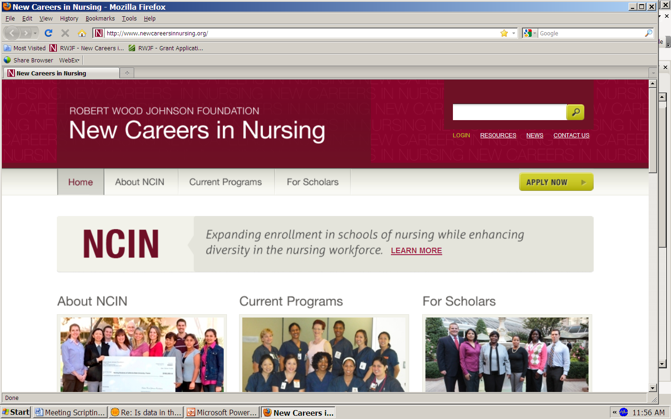

Slide 38
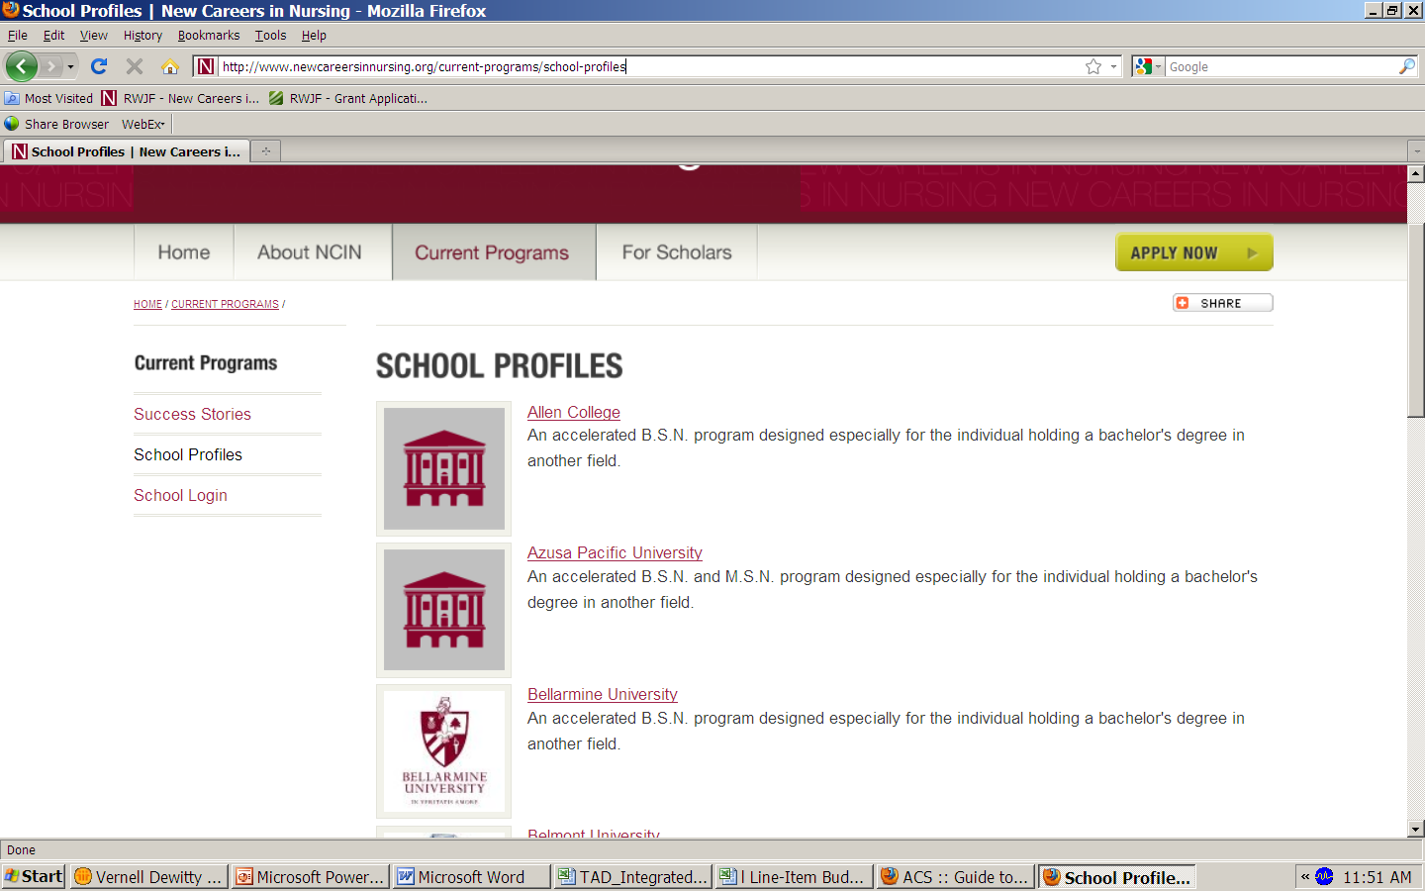
Notes:
Our web site includes school profiles. Last year when we initiated this web based resource we asked schools permission to post your school logo to accompany the description of your program. If we did not receive your logo or permission, we include a generic icon in lieu of the logo.
Within the next week, all new first time grantees will receive a link to review and approve/or edit the content we plan to post to this site. We will also send information for those programs that need updating. Finally, we will send links to past grantees so that you can send us updated or revisions to your school desciption.

Slide 39
Question and Answer
?
Notes:
Now we will entertain more questions and answers.

Slide 40
National Program Office Contact Information
National Program Office Contact Information
Vernell DeWitty
202-463-6930 extension 224
vdewitty@aacn.nche.edu
Alexa Tehansky
202-463-6930 extension 265
Christine Downing
202-463-6930 extension 266
Jihanne Jeanty
202-463-6930 extension 257
Notes:
Thank you for joining us today, we look forward to seeing each of you at the Summits and to our continued work over the next 12 months. Please feel free to contact us at the NPO with any questions and/or comments you may have.
Thank you for joining us today our first web conference. This presentation will be posted to the NCIN website.

