Slide 1
Self-care: Who cares!
Can self-care really impact patient care?
Tracey Motter, MSN
Barb Drew, PhD RN
Michelle Bozeman BSN, RN
Ratchneewan Ross, PhD, RN

Slide 2
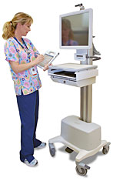
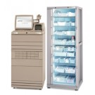
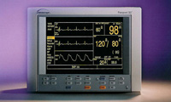
Who cares and why
Nursing 10, 15, 20 years ago vs nursing today

Slide 3
Nursing Students
Families
Financial issues
Personal issues
Generation Y (Milllennials)
  1982-2000
  Racially and ethnically diverse
  Extremely independent
  Feel empowered
  Comfortable with technology
Notes:
Diverse: 61% white non-hispanic down from 80% 17 % hispanic and 16% Black, 5% Asian
Independent: divorce Day care latchkey kids

Slide 4
Generation Y
PROS:
  Adaptable
  Technologically savvy
  Ability to grasp new concepts
  Efficient multi-taskers
  competetive
CONS:
  Impatient- instant gratification
  Skeptical- cheating
  Image is important
  Confident and want answers

Slide 5
Accelerated Students
Outside demands
Financial demands
Demanding curricula
  Baccalaureate Essentials
    Essential VII: Clinical Prevention and Population Health for Optimizing Health
    Essential VIII: Professionalism and Professional Values
  QSEN
    Appreciate the cognitive and physical limits of human performance

Slide 6
Practicing Nurses
Increasing burnout rates:
  New nurses: 13% have changed jobs in 1 year, 37% state they want to leave the profession
  Average turnover rate is 13.9%
  and nurse vacancy rate – 16.1%
Increasing age: average now 47
Increasing demand: 1.2 million more nurses by 2020. (Bureau of Labor Statistics, 2012)
Increasing pressure to improve patient safety and the quality of the patient experience.
  Increasing age of population, higher acuity of patients
                (AACN, 2012)

Slide 7
Practicing nurses
Compassion fatigue
  1992- “loss of ability to nurture”
  Today descriptors
    Borrowed stress
    Disable resiliency
    Emotional contagion
    Empathic strain
    Empathy overload
    Fatal availability
    Soul Pain
                (Boyle, 2011)
Notes:
Secondary vicarious trauma

Slide 8
What’s going on in the world
Financial crisis
Healthcare reform
Unemployment
Student Loans
TV role models – reality shows

Slide 9
Results of increasing demands on students and nurses?
Stress, anxiety, and a decrease in performance outcomes
Need to develop:
  positive ways to deal with stress
  Strategies to help maintain their personal quality of life
  Resilience
  Permission to verbalize emotions/stress
  Permission to take care of themselves physically, spiritually and mentally

Slide 10


Benefits or self-care
Physical
BMI
Spiritual
Notes:
Carol Sedlak, safe pt handling

Slide 11
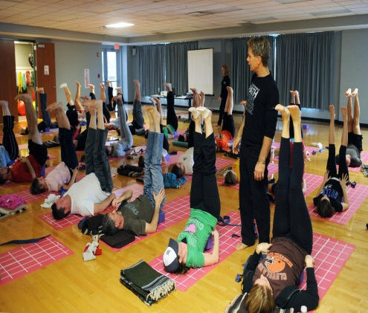

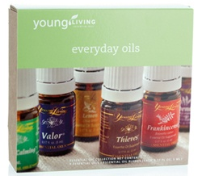
Benefits of Self-care
Mental/Emotional
Notes:
How do we help nurses and students learn to effectively cope with compassion fatigue and prepare them to survive Nursing school and eventually practice.

Slide 12
One Approach!
Background
  Urban Zen work
    Beth Israel Medical Center oncology floor
      Reiki, Breath Awareness, Bedside yoga 85 patients
      Results: No decrease in length of stay however, significant decrease in use of antiemetics, anxiolytic and hypnotic medication costs. (Kligler, Harrison, Levenson, Kenney &Woodson, 2011)
      Donna Karan- similar life events

Slide 13
Benefits of being mindful
Mindfulness- paying full attention to the present moment experience without judgment, elaboration, or emotional reactivity.
                (Jha, Stanley, & Wong, 2010)
    Decreases psychological distress, improved emotional wellbeing. (Greeson & Brantley, 2008)
    Ability to regulate one’s internal emotional experience. (the Amygdala and dorsal cortex)
    Improved attention and concentration
    Improves positive emotions such as compassion
                (Lutz, Refczynski, Johnstone & Davidson, 20080)
Notes:
Greeson and Brantley 8 weeks of mindfulness practice

Slide 14
Benefits of becoming mindful
Physiologic
  Jon Kabat-Zinn- MBSR therapy
    Pain
    HTN
    MI
    Weight control
    IBS
    Insomnia
    HIV
    Substance abuse
    PTSD
Notes:
Compassion fatigue, secondary vicarious trauma

Slide 15
Georgetown University School of Medicine
Dr Aviad Haramati- Prof of Physiology and Biophysics and Medicine
  8 year study with over 1200 participants to measure the effects of practicing mind-body skills has on Perceived stress and Becoming mindful
    Faculty, medical students, grad students nursing students
    10-11 weeks of practicing mind-body skills
      Breathing, meditation, guided imagery, Biofeedback, art, music, writing.
    Findings: participants had a decrease in perceived stress and an increase in mindfulness

Slide 16
KSU and Urban Zen partnership
“The effect of a mind-body self-care module for accelerated nursing students on perceived stress and mindfulness”
  Barbara L. Drew, PhD, RN
  Tracey Motter, MSN, RN
  Ratchneewan Ross, PhD, RN
Purpose: To evaluate an addition to the curriculum of undergraduate accelerated students: experiential exposure to self-care modalities like yoga, breath awareness, and meditation

Slide 17
Hypotheses
Students who participate in mind-body self-care practice during the semester will:
  H1: Perceive less stress by the end of the semester
  H2: Perceive less stress at the end of the semester compared to students who did not participate in mind-body self-care
  H3: Have a greater capacity for mindful attention by the end of the semester
  H4: Have a greater capacity for mindful attention at the end of the semester compared to students who did not participate in mind-body self-care

Slide 18
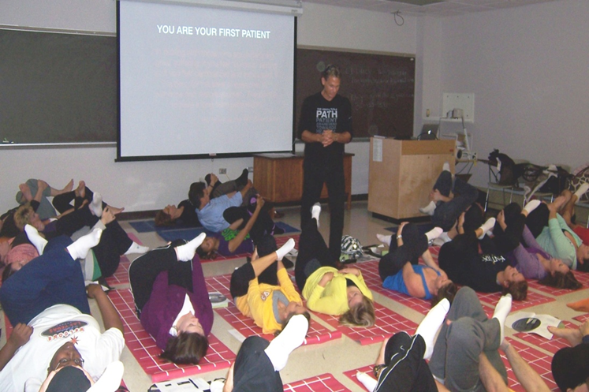
Intervention
One hour per week
Collaboration with Urban Zen Integrative Therapy program
  Yoga practice
  Essential oils
  Reiki
  Breath awareness

Slide 19
Instruments
Dependent Variables
Perceived Stress Scale (PSS; Cohen, Kamarck, & Mermelstein, 1983)
Mindful Attention Awareness Scale (MAAS; Brown & Ryan, 2003
Control Variables
Health Promoting Lifestyle Profile II (HPLP II; Walker, Sechrist, Pender, 1995) The HPLP II served as a control for the health promoting practices the students engage in, independent of the self care module.
Demographic information

Slide 20
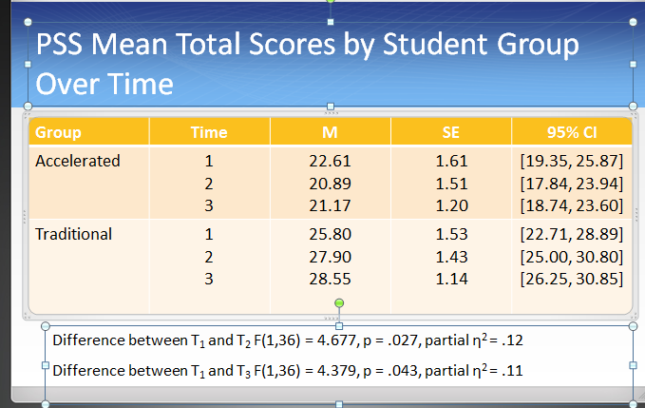
Results

Slide 22
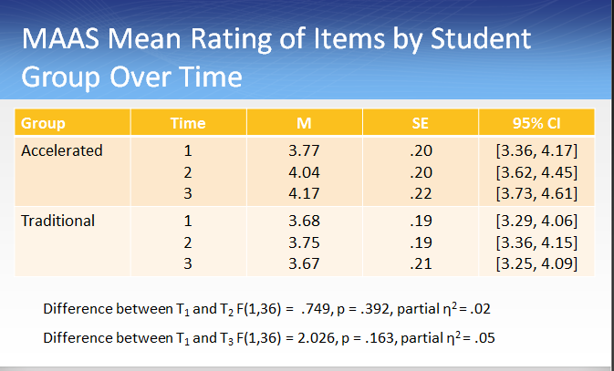

Slide 23
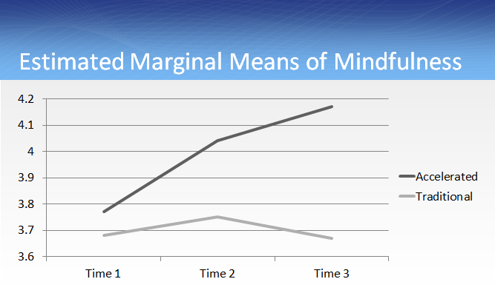

Slide 24
Hypotheses
Students who participate in mind-body self-care practice during the semester will:
H₁: Perceive less stress by the end of the semester Not supported
H₂: Perceive less stress at the end of the semester compared to students who did not participate in mind-body self-care Supported
H₃: Have a greater capacity for mindful attention by the end of the semester Not supported
H₄: Have a greater capacity for mindful attention at the end of the semester compared to students who did not participate in mind-body self-care
        Not supported

Slide 25
Student feedback
I really did enjoy the self-care program, and I truly understand the importance of it. This was a great class to start our first semester of nursing school in. I definitely will continue to practice the self-care strategies that I felt worked for me.
I really enjoyed the yoga class. This class gave me another outlook on ways to handle stress which I think will be very helpful during my career as a nurse. The aromatherapy was my favorite part of the class. I felt they really helped, especially peppermint. I found myself using this and lavender all throughout my first nursing semester. Personally I didn't care for the Reiki portion of the class but it was an experience!
This semester I've found how much of an impact it can have to simply slow down and focus on your wellbeing. It is so easy, especially in the nursing field, to move quickly and worry about everybody else's needs, while neglecting to focus on your own. Each week in yoga I felt that I learned a little bit more about myself, while also finding some self-healing.

Slide 26
Since then….
Developed a Nursing Self-care Consortium-
  Cleveland State University
  Ursuline College of Nursing
Phase 2 Research
  50 Intervention group
  60 Control group
  4 data collection points
Notes:
Mentorship

Slide 27
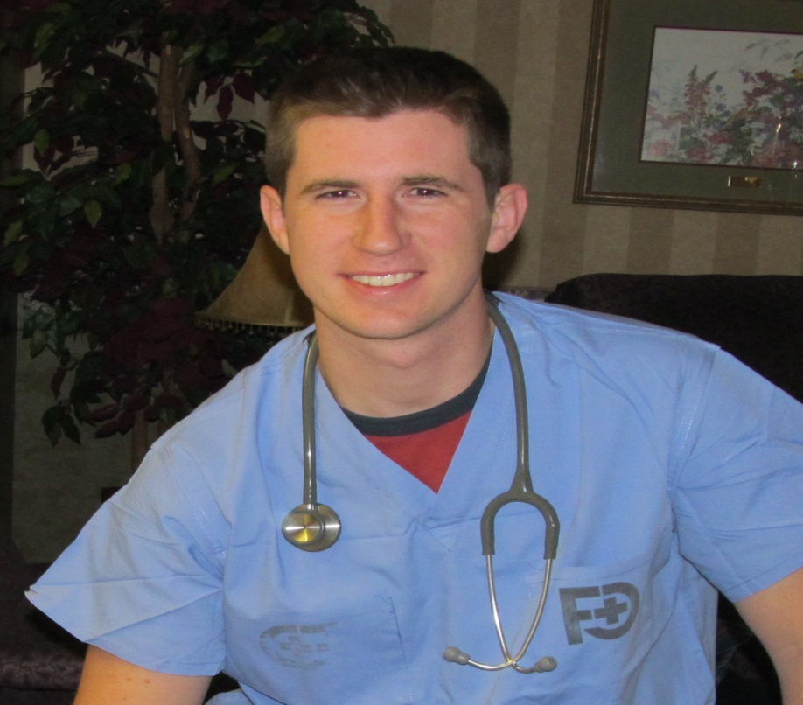
Chris Fogarty

Slide 28
And more……
Driving the Future Annual Conference for Self-care and Wellness
Designing the Future- community event
Changing the Future – Summit involving inter-disciplinary participants across the nation

Slide 29
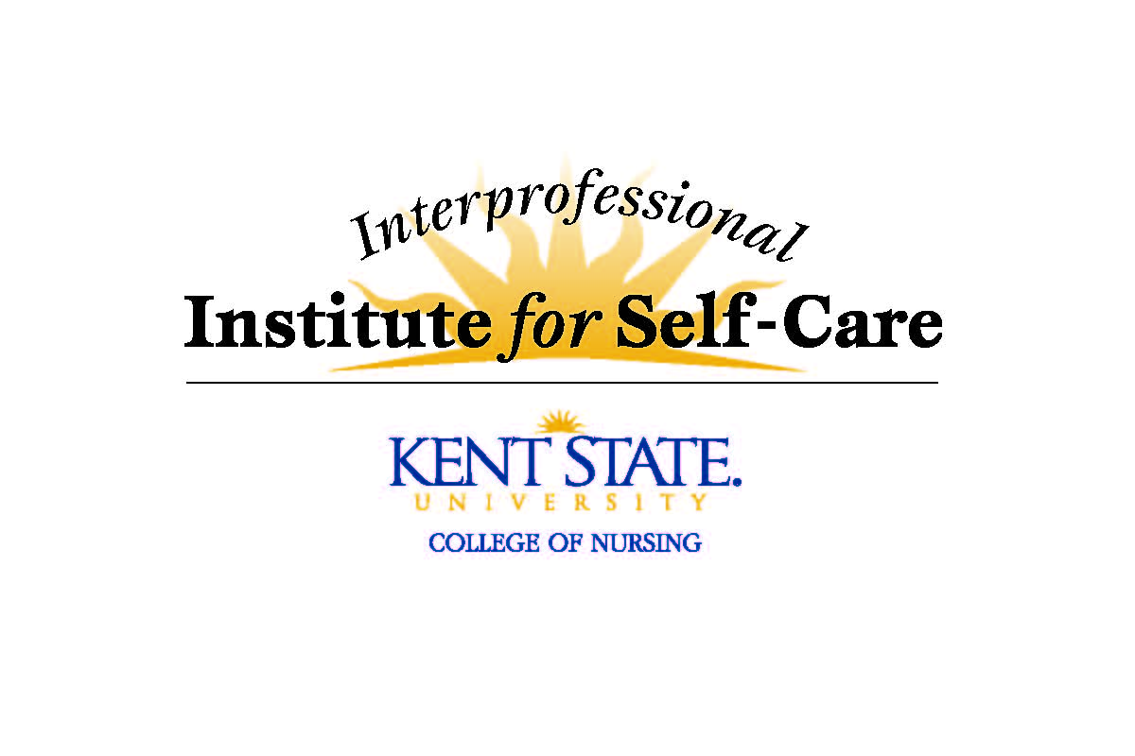
Today……
Interprofessional Institute for Self-Care
Midwest Nursing Research Society-Research section

Slide 30

Where we are going!
Self-care across the curriculum
  Pilots studies for traditional and accelerated beginning students
  Faculty development and training
  Integration into clinical practice
    APPs and tool kit
      STOP
        Stop and pause
        Take a few mindful breaths
        Observe
        Proceed with awareness and kindness

Slide 31
Collaborative partners
Need to continue research to find the answer:
Can self-care really impact patient care?

Slide 32
References
Greeson, J. (2009). Mindfulness research update: 2008. Complementary Health Practice Review, 14, 10-18.
Karpowicz, S., Harazduk, N., & Haramati, A.(2009). Using mind-body medicine for self-awareness and self-care in medical school. Journal of Holistic Healthcare, 6, 19-22.
Kligler, B., Homel, P., Harrison, L., Levenson, H., Kenney, J., & Merrell, W. (2011). Cost savings in inpatient oncology through integrative medicine approach. The American Journal of Managed Care, 17, 779-784.
Nursing Shortage Fact Sheet. (2012). Retrieved from http://www.aacn.nche.edu.

