Slide 1
Technology and On-Line Learning in Accelerated Nursing Education
Allen C. Johnston, Ph.D.
University of Alabama at Birmingham

Slide 2
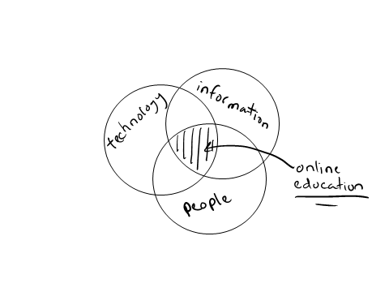
My Way of Thinking
easy to spot problems
difficult to spot opportunities
education can be focused anywhere, but online education is at the center
culture dictates options
strategic alignment of technology to values and processes

Slide 3
A culture change
Understanding the cultural challenge of online learning
Notes:
Assuming we value online learning and accelerated education…

Slide 4
Conventional Learning Environments
face-to-face instruction
Notes:
Students appear for classes a few days per week
Face-to-face lectures
In-class discussions
Homework

Slide 5
Conventional Learning Environments
relatively slower programs
allow students to mature
have breaks between terms
only a few courses per term allowing for other pursuits, interests
Notes:
Social influence is sporadic
Not cohort oriented

Slide 6
Conventional Learning Environments
lead users
hard to spot
harder to support
Notes:
Image source: www.zephram.de
Lead users are those that anticipate needs, recognize trends, are socially centric, communicate often, and are influential. They value recognition and feedback by the instructor, a platform for communication, and empowerment to make change (influence). They generally develop and spend a great deal of social capital over the duration of a course or term.
Possess unique knowledge, play an early role in learning activities, possess strong reputations within their communities, help shape innovative solutions to problems
“Lead users” are present
Difficult to identify
Harder to support effectively
Feedback and recognition
Socially-centric
Anticipate needs
Recognize trends
Even harder to leverage for the benefit of everyone (shared cognition, collective efficacy)
Community leaders
Can draw community together
Can help generate innovative collective solutions to problems

Slide 7
A Culture of Learning
culture develops over time
values dictate …
Processes, which require …
resources
if the goal is consistent outcomes, processes are essential and a culture is desirable
if the goal is consistently “good” outcomes, practice must be valued
Notes:
Christensen, C. M., and Overdorf, M. 2000. “Meeting the Challenge of Disruptive Change,” Harvard Business Review.
Values
Standards by which an institution sets priorities that enable them to judge whether or not a program, learning environment, or learning approach is attractive or unattractive
Processes
The “patterns of interaction, coordination, communication, and decision making” that turn resources into some of value
Resources
The human, technological, knowledge, and students (raw materials) that serve as input to the processes

Slide 8
Conventional Learning Environments
conventional learning environments utilized technology in a way that supported their conventional values
for these established cultures to remain effective they required only evolutionary (sustaining) technologies
email (asynchronous, in-line with course schedules, nature of work)
powerpoint (simplex information flow, in-line with content delivery)
Notes:
Christensen, C. M., and Overdorf, M. 2000. “Meeting the Challenge of Disruptive Change,” Harvard Business Review.

Slide 9
Evolutionary Versus Revolutionary Technologies
evolutionary technologies are sustaining technologies
enhance processes, support values, entrench cultures
revolutionary technologies are game changers
disrupt processes, challenge values, threaten established cultures
we’ve already seen this with the Internet, smart devices, mobile apps

Slide 10
Contemporary Online Learning Environments
to effectively depart from the culture of conventional learning environments …
communicate new values
leadership teams
establish unique processes
extended engagement
procure new resources
human resources: mature, focused, and inherently motivated students
technological resources: collaborative, synchronous, half or full-duplex, social
Notes:
Who do these students sound like?

Slide 11
Contemporary Online Learning Environments
communicate new values
learning can occur in compressed timeframes
learning can occur in extended engagement, online environments
socially constructed knowledge
traditional experiences aren’t always the “best” experiences

Slide 12
Contemporary Online Learning Environments
communicate new values
practice has value too
overly-standardized practices can produce consistent student experiences but not consistently effective student experiences
informal learning environment is important
social influence, vicarious experience, situational support
community-focused

Slide 13
Contemporary Online Learning Environments
establish unique processes to support the new values
extended engagement
faster paced
more intensive
cohort oriented
socially intensive – a social construction of knowledge
“lead users” influence is amplified
how do we harness their power?

Slide 14
Contemporary Online Learning Environments
procure new resources to support the unique processes
human resources: recruit mature, educated, focused, and inherently motivated students
technological resources: acquire collaborative, synchronous, half or full-duplex, social technologies
microblogs (half-duplex, social)
social networks (half-duplex, social)
wikis (collaborative, lead user platform)
mobile apps (social, collaborative, situational)

Slide 15
An exemplary approach
Integrating technology into an online learning environment
Notes:
Assuming we value online learning and accelerated education…

Slide 16
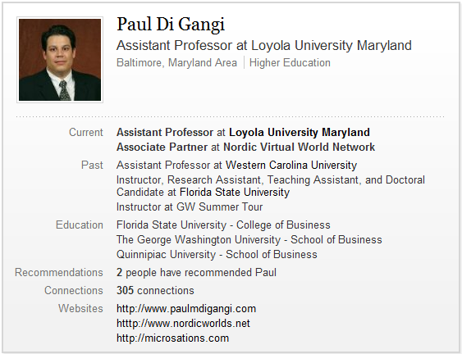
An Exemplary Approach Paul Di Gangi, Ph.D.
Contact @ pdigangi@uab.edu Website @ www.paulmdigangi.com

Slide 17
PAR Approach to Online Learning
Planning
Action
Review

Slide 18
Planning
Notes:
Image Source: http://www.flickr.com/photos/47480308@N02/6375093979/sizes/o/in/photostream/

Slide 19
Planning – Identify Current Issues
Notes:
Image Source: http://www.flickr.com/photos/47480308@N02/6375093979/sizes/o/in/photostream/

Slide 20
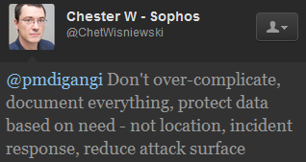
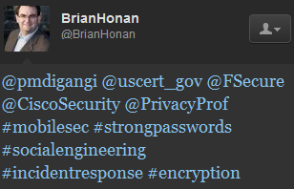
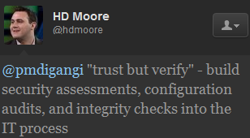
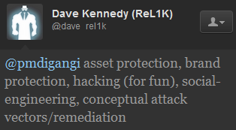
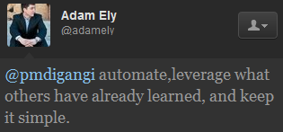
Planning – Identify Current Issues
Notes:
Image Source: http://www.flickr.com/photos/47480308@N02/6375093979/sizes/o/in/photostream/

Slide 21
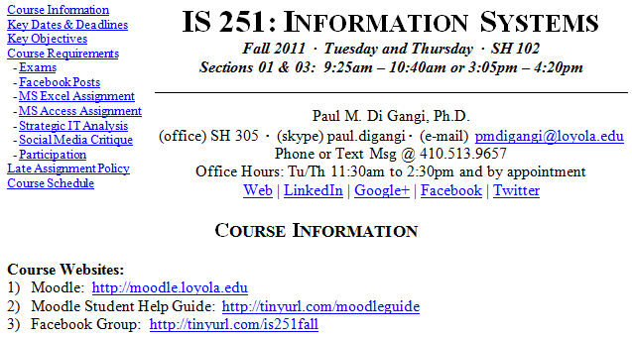
Planning - Syllabus
Bookmarks for navigation
Google Voice
Notes:
Image Source: http://www.flickr.com/photos/47480308@N02/6375093979/sizes/o/in/photostream/

Slide 22
Action
Notes:
Image Source: http://www.flickr.com/photos/47480308@N02/6375093979/sizes/o/in/photostream/

Slide 23
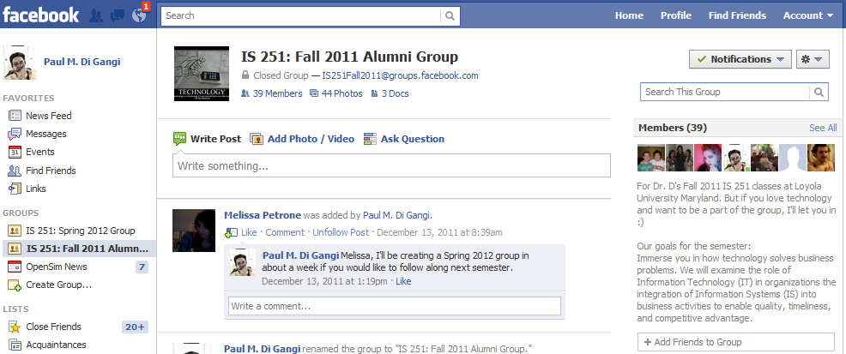
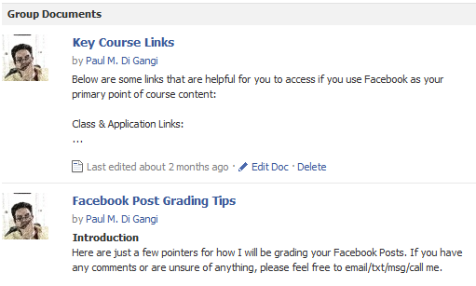

Slide 24
Action – Build Anticipation
Notes:
Image Source: http://www.flickr.com/photos/47480308@N02/6375093979/sizes/o/in/photostream/

Slide 25
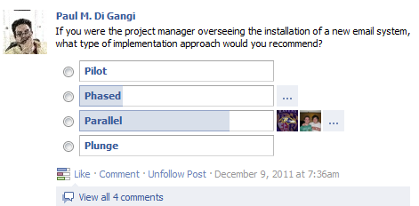
Action - Practice
Notes:
Image Source: http://www.flickr.com/photos/47480308@N02/6375093979/sizes/o/in/photostream/

Slide 26
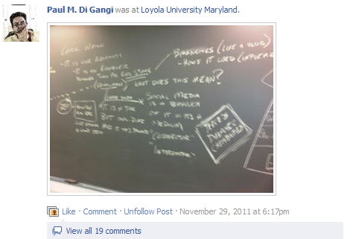
Action – Enable Discussion
Notes:
Image Source: http://www.flickr.com/photos/47480308@N02/6375093979/sizes/o/in/photostream/

Slide 27
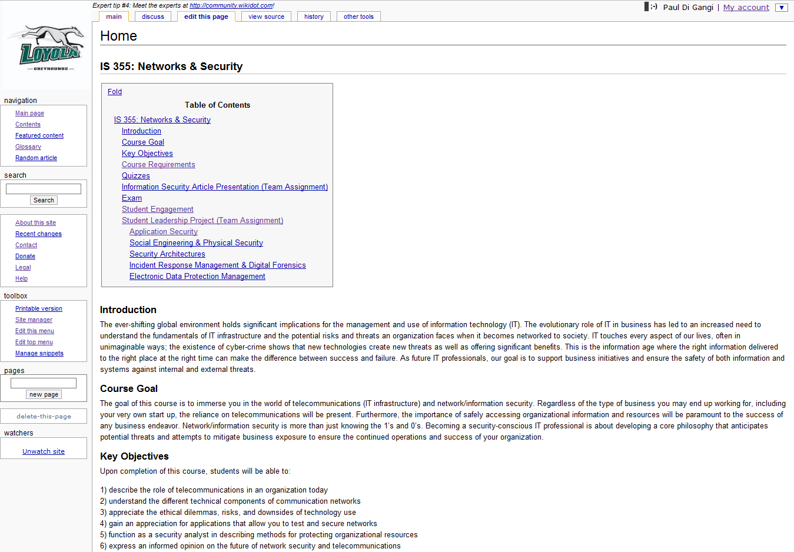
300 edits by 5 groups

Slide 28
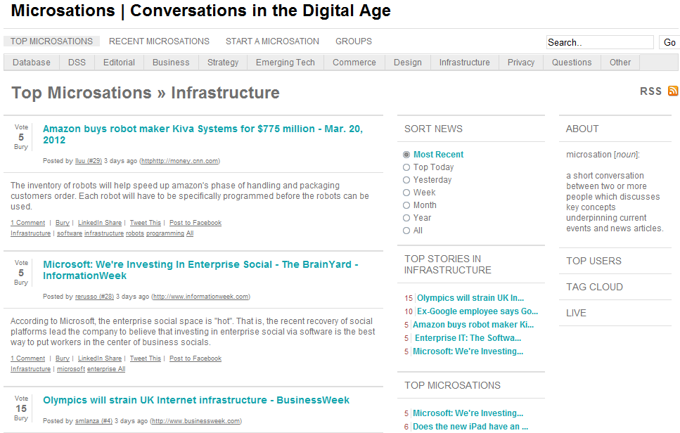
1,847 Stories; 2,097 Comments; 5,490 Votes; 180 Students

Slide 29
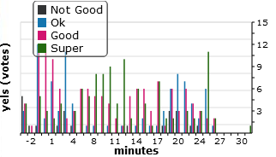
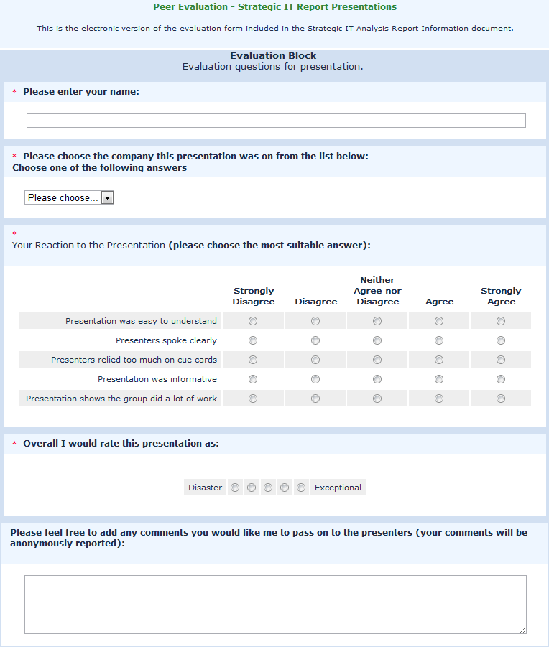
Student Presentations

Slide 30
Review
Notes:
Image Source: http://www.flickr.com/photos/47480308@N02/6375093979/sizes/o/in/photostream/

Slide 31
Review

Slide 32
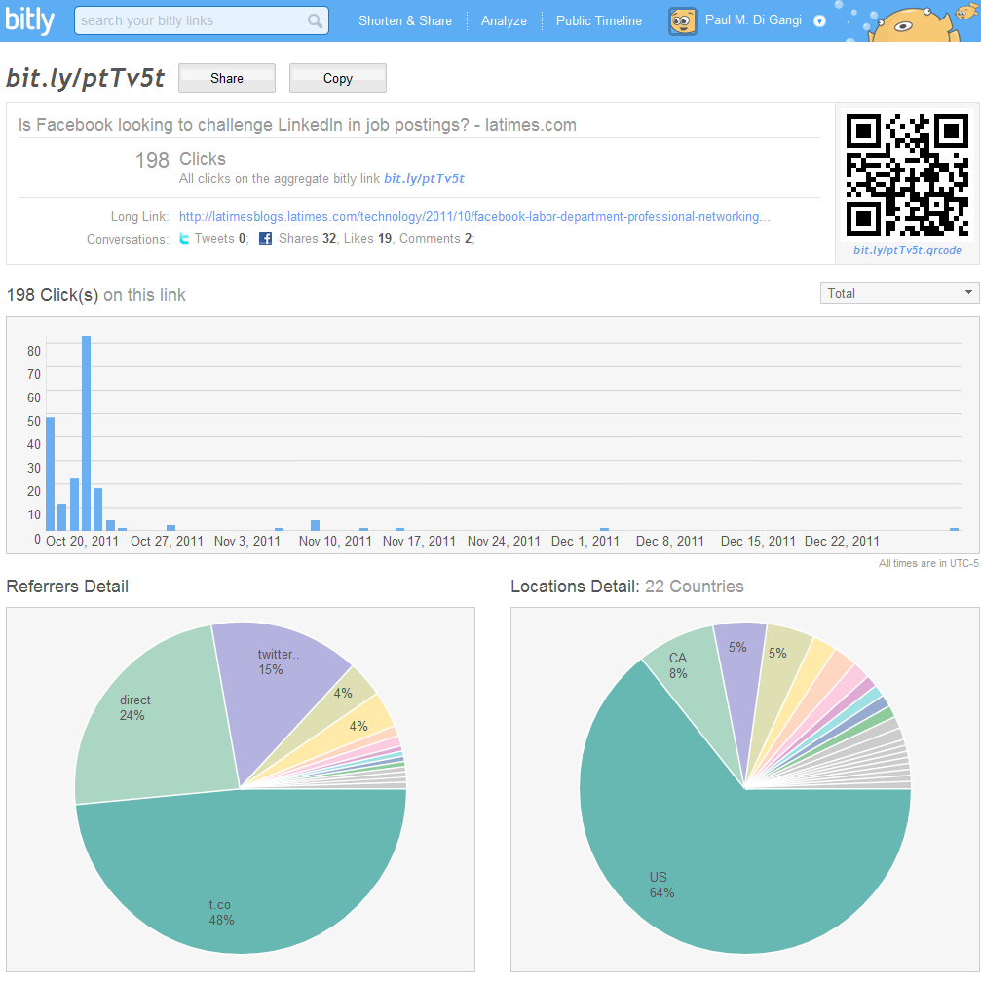
Review

Slide 33
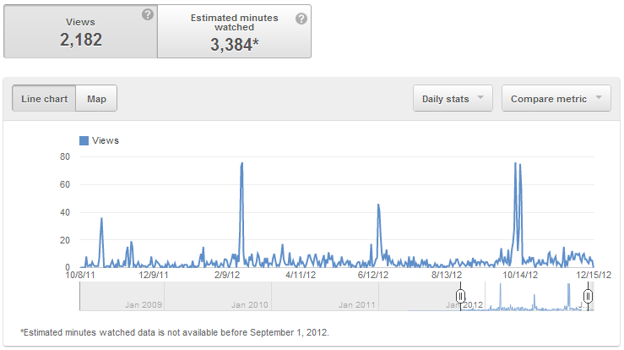
Video Lectures
96 Countries

Slide 34
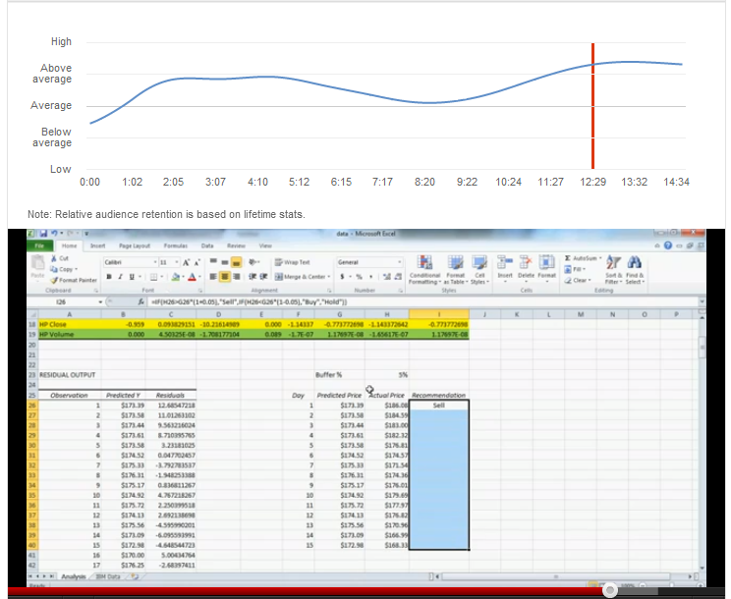
Granularized Feedback

Slide 35
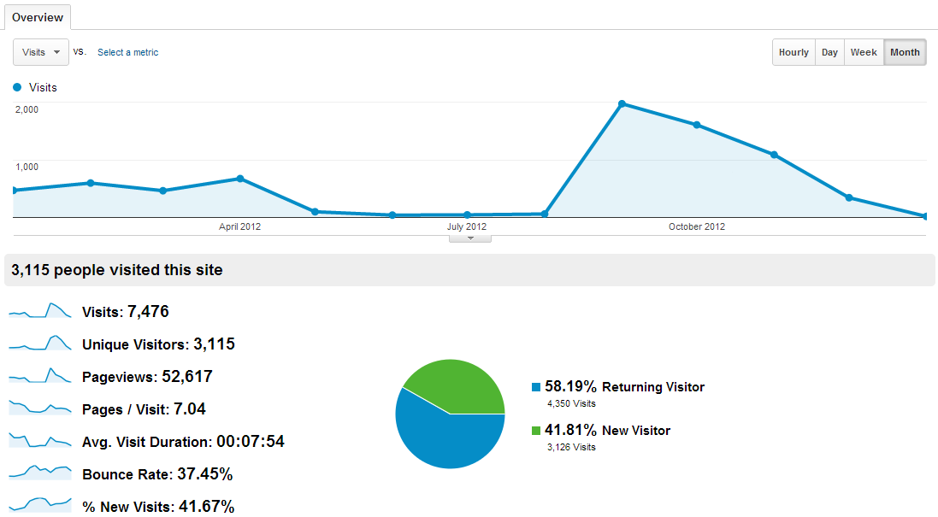
Microsations

Slide 36
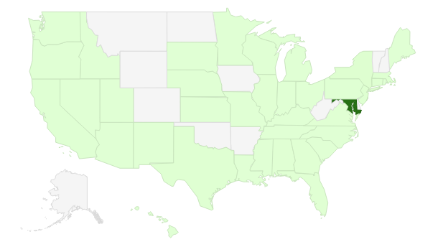
Microsations

Slide 37
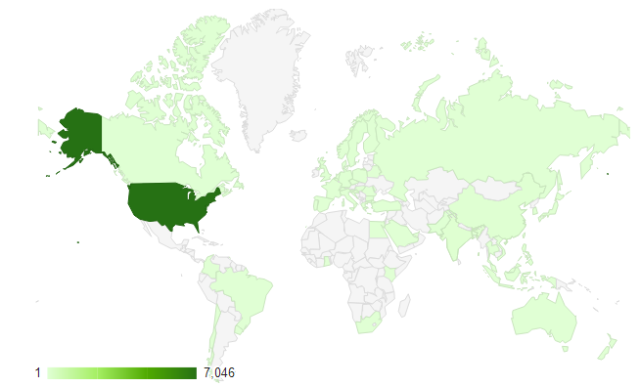
Microsations

Slide 38
Technology and On-Line Learning in Accelerated Nursing Education
Allen C. Johnston, Ph.D.
University of Alabama at Birmingham

