Slide 1
Looking is not seeing and listening is not hearing
Linda Honan PhD, APRN, Yale University
Sarah Shealy, MSN, CNM, Mount Saint Marys University
Thomas C Duffy, Professor
Yale University School of Music
Linda Friedlaender, Curator for Education
Yale Center for British Art

Slide 2
Looking
The art of diagnosis begins with seeing…
“Never trust to general impressions, my boy, but concentrate yourself upon details.” Sherlock Holmes
Details, details, details

Slide 3
The Process
The initial goal is not interpretations or analysis; rather it is verbalization of observations
Do a visual inventory; what do you see?
Do not jump to themes! Begin with objects, how many? Describe them. Color? Dress?
No subjective statements- only objective. Describe, describe, describe…
Unpack the picture- do all four corners

Slide 4
Its your turn…

Slide 5
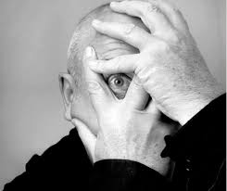
Development of perceptual skills is a critical yet complex skill that requires the effective organization and interpretation of data using visual, and auditory clinical observation.

Slide 6
Demographics of MSMU Participants (n=22)
Characteristic | Frequency (%)
Age 18-24 25-29 30-50 | 5 (22.7) 9 (40.9) 8 (36.4)
Female Male | 19 (86.4) 3 (13.6)
Type of Undergraduate Degree Bachelor of Arts Bachelor of Science | 14 (63.6) 8 (36.4)
Type of Graduate Degree Masters of Art Worked prior to school | 1 (4.5) 20 (90.9)
Able to read music | 7 (31.8)
Ever had music lessons* | 14 (63.6)
Ever had art training | 8 (36.4)
Visual impaired Hearing impaired | 2 (9.0) 0 (0.0)
Notes:
*Mean years of musical lessons is 2 years (SD=2.8)

Slide 7
The pretest

Slide 9
LACMA
Following a visual inventory of an art piece, student were stretched to note manner and mood in the painting, where was the light coming from (if appropriate)? They noted posture, body language- what did the positions convey?
Themes- cluster the observations that relate to themes

Slide 10
The experience…

Slide 12
The study
Students who participated in the looking is not seeing experience had significantly more written observations;
higher number of objective physical assessment findings; more objective physical assessment findings on the patient photographs, and…
 | Pre | Post | Wilcoxon Signed rank Test (P)
Variable | Mean | Mean
Image 1 (arm DVT) Total word count | 142.73 | 148.52 | 0.6023
Total number of observations | 21.23 | 31.33 | 0.0003
Number of objective physical assessment findings | 7.95 | 16.33 | <.0001
Number of diagnoses | 0.64 | 1.67 | 0.0006
Image 2 (COPD)
Total word count | 143.45 | 173.90 | 0.0097
Total number of observations | 26.86 | 33.62 | 0.0186
Number of objective physical assessment findings | 8.00 | 12.57 | 0.0003

Slide 13
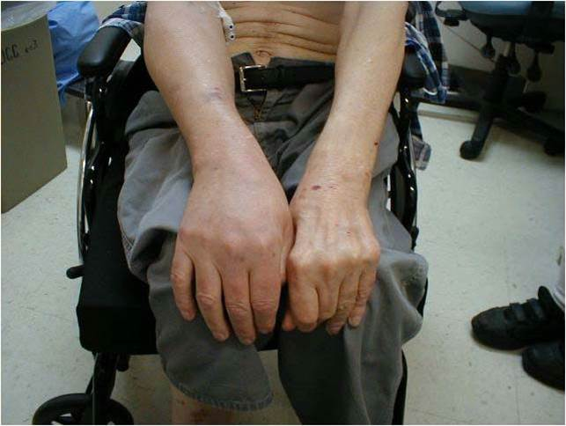
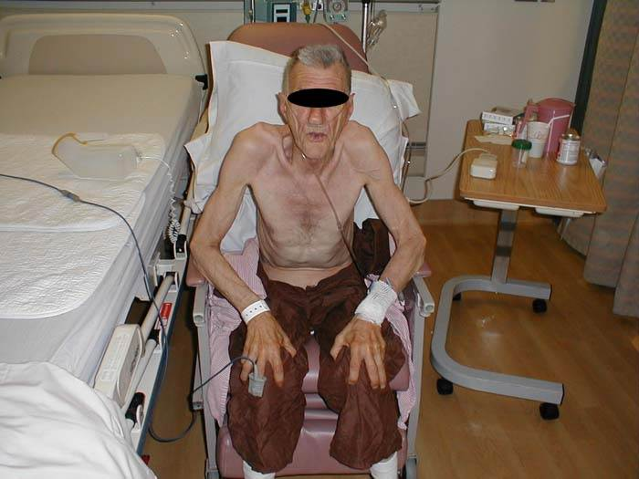
Correct diagnosis based on assessment of signs
 | Pre |  | Post
Variable | Correct | % | Correct | %
Image 1 Correct Diagnosis of arm DVT | 1 | 4.55 | 14 | 66.67
Image 2 Correct Diagnosis of COPD | 14 | 63.64 | 19 | 90.48

Slide 14
Differential diagnosis
“Circumstantial evidence is a very tricky thing. It may seem to point very straight to one thing, but if you shift your own point of view a little, you may find it pointing in an equally uncompromising manner to something entirely different” Holmes
Fluid, flexible seeing

Slide 15
Consider that…
Seeing is constructed, flexible and fluid. Observational skills can be enhanced with the use of art work and the experience translates into deeper seeing that results in enhanced diagnostic skills.

Slide 16
Listening is not hearing
The auditory arts are integrated with nursing science to develop curriculum for training students’ listening skills in pitch, frequency, and discrimination

Slide 17
Dynamics
Beats can be played very loudly or very softly and everything in between.
The volume of a sound is called its dynamic.
p = piano = soft
ppp = triple piano extremely soft
f = forte = loud (strong)

Slide 18
Music…
Musical samples as sounds, in tandem with the visual notational diagram of each sound’s rhythm, articulation, speed and volume.
Masking…
Systolic Murmur
Actual Systolic Murmur
Diastolic Murmur
Actual Diastolic Murmur

Slide 19
 | Number of Sounds | Baseline |  | Post education |  | % Improvement | Wilcoxon signed rank
 |  | Mean Score | % | Mean Score | %
Correctly identified organ (heart, lung or bowel combined) | 25 | 21.78 | 87.12 | 23.39 | 93.56 | 7.39 | 0.0051
Correctly identified specific organ sound | 25 | 4.91 | 19.64 | 10.65 | 42.60 | 116.90 | <.0001
Correctly identified specific heart sound | 10 | 0.96 | 9.60 | 3.48 | 34.80 | 262.50 | <.0001
Correctly identified organ as lung | 10 | 9.04 | 90.40 | 9.56 | 95.60 | 5.75 | .0418
Correctly identified specific lung sound | 10 | 2.04 | 20.40 | 4.26 | 42.60 | 108.82 | .0003
Correctly identified organ as bowel | 5 | 3.39 | 67.80 | 4.48 | 89.60 | 32.15 | .0038
Correctly identified specific bowel sound | 5 | 1.91 | 38.20 | 2.91 | 58.20 | 52.36 | 0.0117

Slide 20
Specifics
Sound | Percent properly identifying sound |  | % Improvement
 | N - Pre test (N-23) | Post test (N-23_
Systolic murmur | N-0; 0% | N-7 30.43% | 30.43%
Diastolic murmur | N-0; 0% | N-16 69.57% | 69.57%
S4 | N-1; 4.35% | N-12 52.7% | 50%
Normal breath sounds | N-0; 0% | N-13 56.52% | 56.52%
Stridor | N-2; 8.70% | N-13 56.52% | 52.38%
Whispered pectoriloquy | N-0; 0% | N-11 47.83% | 47.83%
Normal bowel sound | N- 4; 17.39 % | N-10 43.48 % | 36.84%
Hypoactive bowel sounds | N-9; 39.13 % | N-19 82.61% | 85.71%
Notes:
)]. Results revealed minimal accuracy in lung sound interpretation; wheezes which were interpreted most frequency were only correctly deduced 52.1% of the time, whereas fine crackles were correctly interpreted only 2.1%.
In Mangione’s (2001) study of medical residents in the United States [US], Canada and England, correct interpretation of 12 cardiac sounds was made 22%, 26%, and 20% of the time, respectively. Perhaps more concerning is evidence that only one quarter of US residencies in internal medicine and family practice (Mangione, 1998), and 37.1% of cardiology programs (Mangione, Nieman, Gracely, & Kaye, 1993) provided formal training in cardiac auscultation despite trainees request for this teaching. Researchers suggest the low emphasis on cardiac examination is related to an over-reliance in expensive technology, decreased incidence of valvular diseases in Western world (Bisno, 1987)
26.3%

Slide 21
The future
The humanities are a valuable element of nursing education, yet the type of “humanities” has been constrained in nursing education. Our research reveals that arts and music bring a new lens through which students can learn valuable skills.

Slide 22
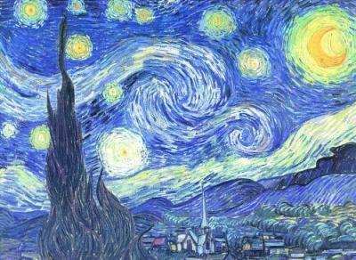
Art work images from Yale Center for British Art and LACMA
Patient Photographs from Charles Goldberg, and Jan Thompson, UCSD and personal photographs
This research was supported by Sigma Theta Tau Int., National League for Nursing, Johnson & Johnson/Global Alliance for Arts & Health Partnership to Promote the Arts in Healing; Robert Wood Johnson

