Slide 1
Looking is not seeing and listening is not hearing
Linda Honan PhD, APRN, Yale University
Thomas C Duffy, Professor
Yale University School of Music
Linda Friedlaender, Curator for Education
Yale Center for British Art

Slide 2
Looking
The art of diagnosis begins with seeing…
“Never trust to general impressions, my boy, but concentrate yourself upon details.” Sherlock Holmes
Details, details, details

Slide 3
The Process
The initial goal is not interpretations or analysis; rather it is verbalization of observations
Do a visual inventory; what do you see?
Do not jump to themes! Begin with objects, how many? Describe them. Color? Dress?
No subjective statements- only objective. Describe, describe, describe…
Unpack the picture- do all four corners

Slide 4
An example…

Slide 5
LACMA
Following a visual inventory of an art piece, student were stretched to note manner and mood in the painting, where was the light coming from (if appropriate)? They noted posture, body language- what did the positions convey?
Themes- cluster the observations that relate to themes

Slide 6
The experience…

Slide 7
After the museum

Slide 10
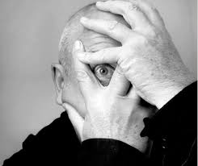
Development of perceptual skills is a critical yet complex skill that requires the effective organization and interpretation of data using visual, and auditory clinical observation.

Slide 11
The study
Students who participated in the looking is not seeing experience had significantly more written observations;
higher number of objective physical assessment findings; more objective physical assessment findings on the patient photographs, and…
 | Pre | Post | Wilcoxon Signed rank Test (P)
Variable | Mean | Mean
Image 1 (arm DVT) Total word count | 142.73 | 148.52 | 0.6023
Total number of observations | 21.23 | 31.33 | 0.0003
Number of objective physical assessment findings | 7.95 | 16.33 | <.0001
Number of diagnoses | 0.64 | 1.67 | 0.0006
Image 2 (COPD)
Total word count | 143.45 | 173.90 | 0.0097
Total number of observations | 26.86 | 33.62 | 0.0186
Number of objective physical assessment findings | 8.00 | 12.57 | 0.0003

Slide 12
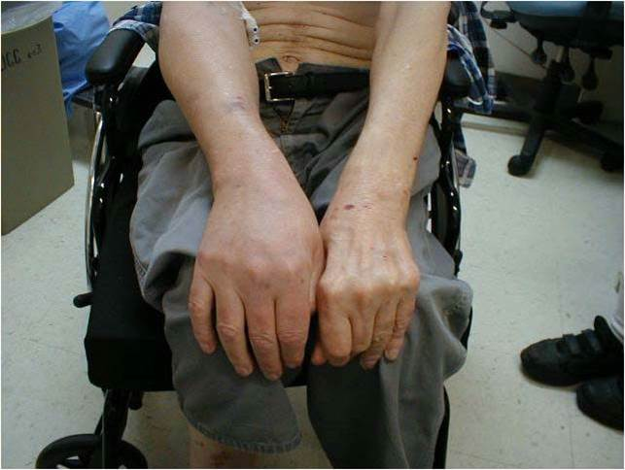
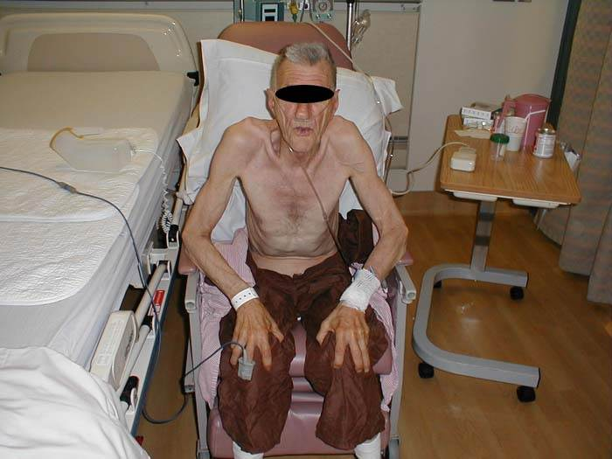
Correct diagnosis based on assessment of signs
 | Pre |  | Post
Variable | Correct | % | Correct | %
Image 1 Correct Diagnosis of arm DVT | 1 | 4.55 | 14 | 66.67
Image 2 Correct Diagnosis of COPD | 14 | 63.64 | 19 | 90.48

Slide 13
Differential diagnosis
“Circumstantial evidence is a very tricky thing. It may seem to point very straight to one thing, but if you shift your own point of view a little, you may find it pointing in an equally uncompromising manner to something entirely different” Holmes
Fluid, flexible seeing

Slide 14
Consider that…
Seeing is constructed, flexible and fluid. Observational skills can be enhanced with the use of art work and the experience translates into deeper seeing that results in enhanced diagnostic skills.

Slide 15
Listening is not hearing
The auditory arts are integrated with nursing science to develop curriculum for training students’ listening skills in pitch, frequency, and discrimination

Slide 16
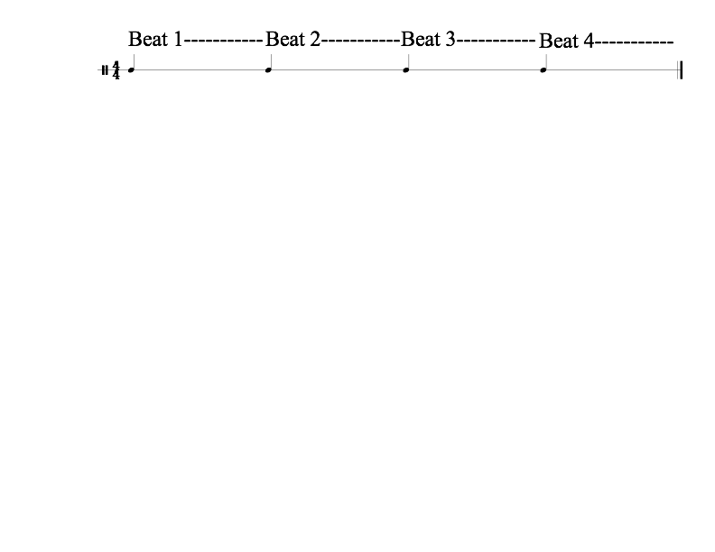
General Idea of Number in Sound
One beat is a unit of time. In a measure with 4 beats, beat one lasts from the point where it is first heard until the next beat is heard.

Slide 17
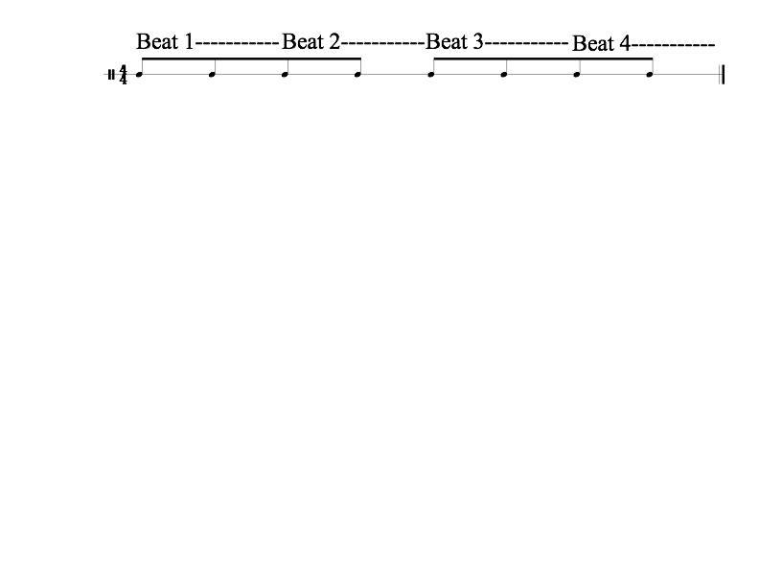
General Idea of Number in Sound
One beat is a unit of time. In a measure with 4 beats, beat one lasts from the point where it is first heard until the next beat is heard.
Beats can be divided into smaller subdivisions.

Slide 18
Dynamics
Beats can be played very loudly or very softly and everything in
between. The volume of a sound is called its dynamic.
p = piano = soft
ppp = triple piano extremely soft
f = forte = loud (strong)
fff = triple forte = very loud

Slide 19
Accents
Some beats are stronger than others, they are “accented.”

Slide 20
What do you hear?
How many different “sound-scapes” do you hear?
When does the first sound-scape end?

Slide 21
What do you hear?
How many different “sound-scapes” do you hear?
When does the first sound-scape end?

Slide 22
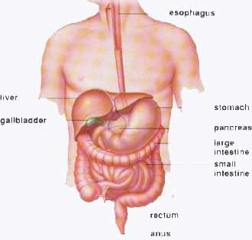
Bowel Sounds

Slide 23
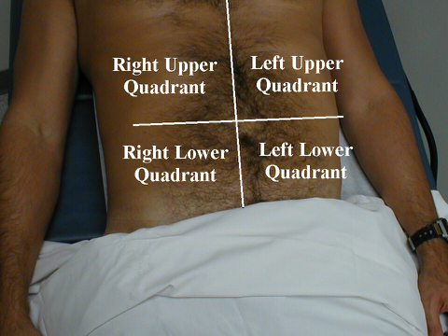

Slide 24
Bowel Sounds
Count the bowel sounds over this 20 second
sample and multiply by three for the
“per minute” value.

Slide 25
Bowel Sounds - Normal

Slide 26
Bowel Sounds
Count the bowel sounds over this 20 second
sample and multiply by three for the
“per minute” value.

Slide 27
Bowel Sounds - Hyperactive

Slide 28
Bowel Sounds
Count the bowel sounds over this 20 second
sample and multiply by three for the
“per minute” value.

Slide 29
Listening Test: Real Bowel Sounds
Real Bowel Sounds A.
Real Bowel Sounds B.
Real Bowel Sounds C.
Your Choices: Normal, Hyper or Hypo.
Notes:
Hyper, Normal Hypo

Slide 30
Listening Test: Real Bowel Sounds
Real Bowel Sounds A.
Real Bowel Sounds B.
Real Bowel Sounds C.
Your Choices: Normal, Hyper or Hypo.
Notes:
Hyper, Normal Hypo

Slide 31
Listening Test: Real Bowel Sounds
Answer:
Real Bowel Sounds A.
Hyper
Real Bowel Sounds B.
Real Bowel Sounds C.
Your Choices: Normal, Hyper or Hypo.
Notes:
Hyper, Normal Hypo

Slide 32
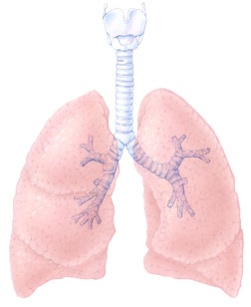
Lung Sounds

Slide 33
Lung Sounds
Exercise: Labeling sounds makes them easy to hear!
WHAT DO YOU HEAR?
SECRETS:

Slide 34
Lung Sounds
Exercise: Labeling sounds makes them easy to hear!
WHAT DO YOU HEAR?
SECRETS:

Slide 35
Respiration

Slide 36
Real Lung Sound

Slide 37
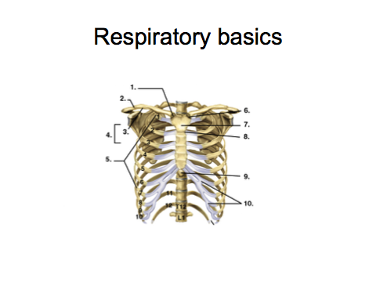

Slide 38
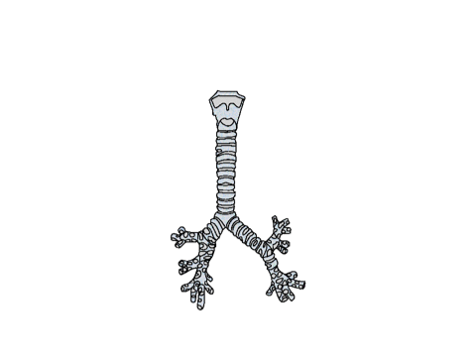

Slide 40
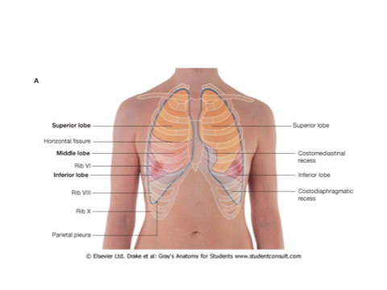

Slide 41
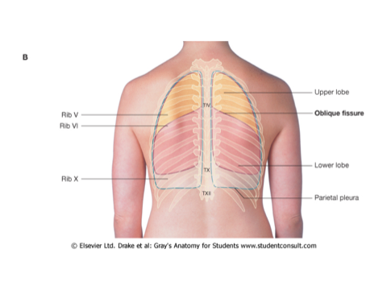

Slide 43
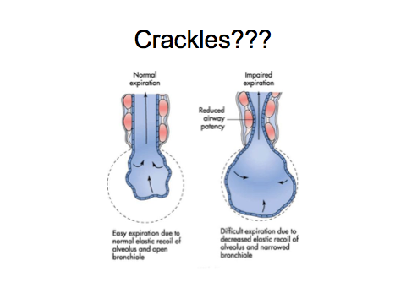

Slide 45
Lungs - Wheeze on expiration

Slide 46
Lungs - Wheeze on inspiration

Slide 47
Wheeze Test.
A. Clear Lungs.
B. Wheeze on inhale and exhale.
C. Wheeze on inhale only.
D. Wheeze on exhale only.
• You will hear four consecutive sets of inhalations and expirations.
• There is one sound from each of the categories above.
• What is the correct order?

Slide 48
Wheeze Test.
A. Clear Lungs.
B. Wheeze on inhale and exhale.
C. Wheeze on inhale only.
D. Wheeze on exhale only.

Slide 49
Wheeze Test.
A. Clear Lungs.
B. Wheeze on inhale and exhale.
C. Wheeze on inhale only.
D. Wheeze on exhale only.
A D C B

Slide 50
Clear Normal Lung

Slide 51
Consolidation
Lung sounds moving down the chest

Slide 52
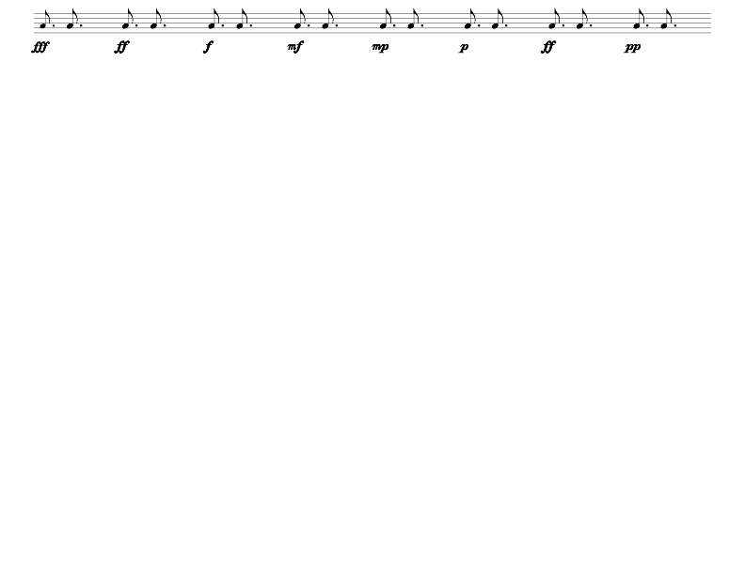
Real Lung Sound
“1…2…3…” Whispered Pectorilloquy

Slide 53
Real Lung Sound
“1…2…3…” Whispered Pectoriloquy

Slide 54
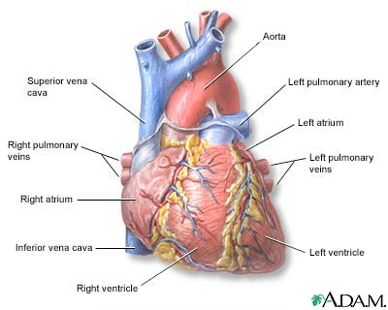
Heart Sounds

Slide 55
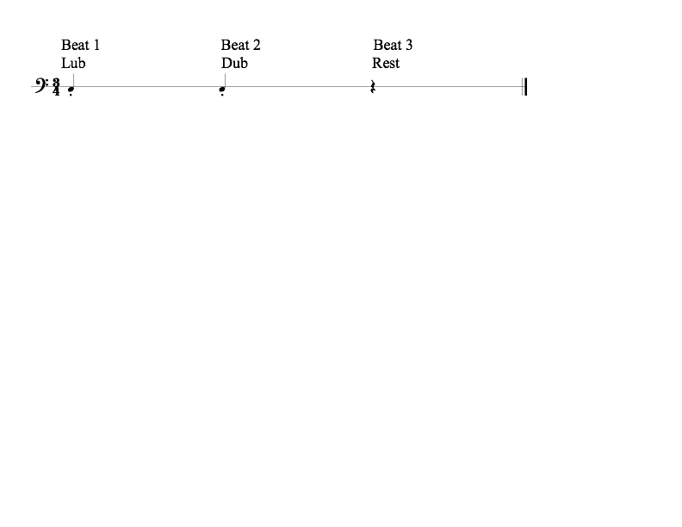
Heart Sounds - Tripartite domains

Slide 58
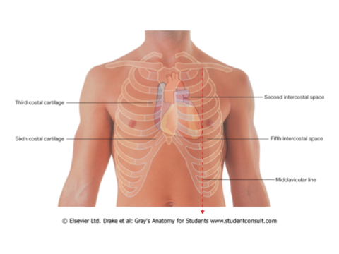

Slide 59
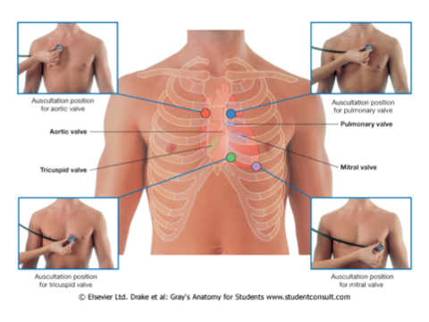

Slide 60
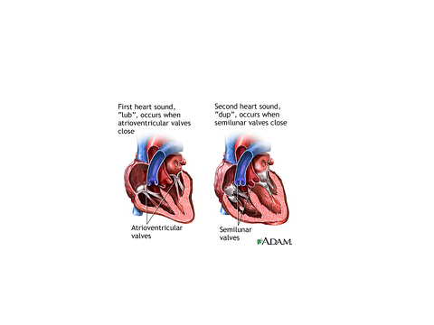

Slide 61
Heart Sounds - Middle Area

Slide 62
Heart Sounds - Apex
Middle Area
Apex - Bottom

Slide 63
Heart Sounds - Base
Middle Area
Base - Top

Slide 64
Review. Choose from:
A. Normal beats. (Middle area.) Equal
B. Base beats (Upper area.) Accent on 2
C. Apex beats (Lower area.) Accent on 1
Real heart sounds:
Sample 1.
Sample 2.

Slide 65
Review. Choose from:
A. Normal beats. (Middle area.) Equal
B. Base beats (Upper area.) Accent on 2
C. Apex beats (Lower area.) Accent on 1
Real heart sounds:
Sample 1.
Sample 2.

Slide 66
Review. Choose from:
A. Normal beats. (Middle area.) Equal
B. Base beats (Upper area.) Accent on 2
C. Apex beats (Lower area.) Accent on 1
Real heart sounds:
Sample 1.
Answer:
Sample 1 is B-Base beats
Sample 2.

Slide 67
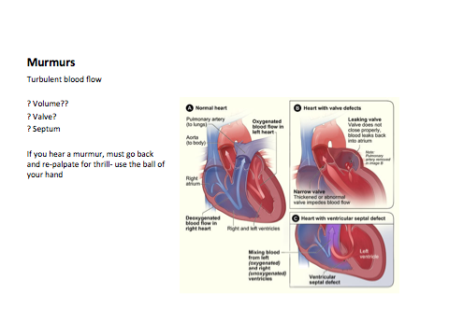

Slide 68
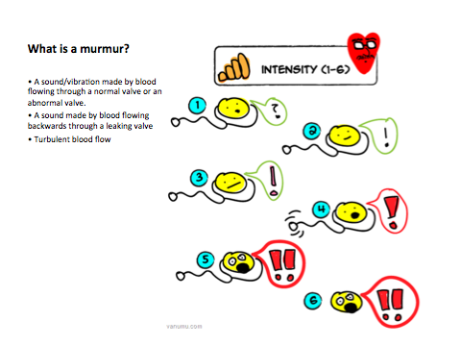

Slide 70
Heart - Systolic Murmur
Middle
Systolic Murmur

Slide 71
Heart - Systolic Murmur
90 bpm
Middle
Systolic Murmur
Systolic Murmur

Slide 72
Heart - Systolic Murmur
120 bpm
Middle
Systolic Murmur
Systolic Murmur

Slide 73
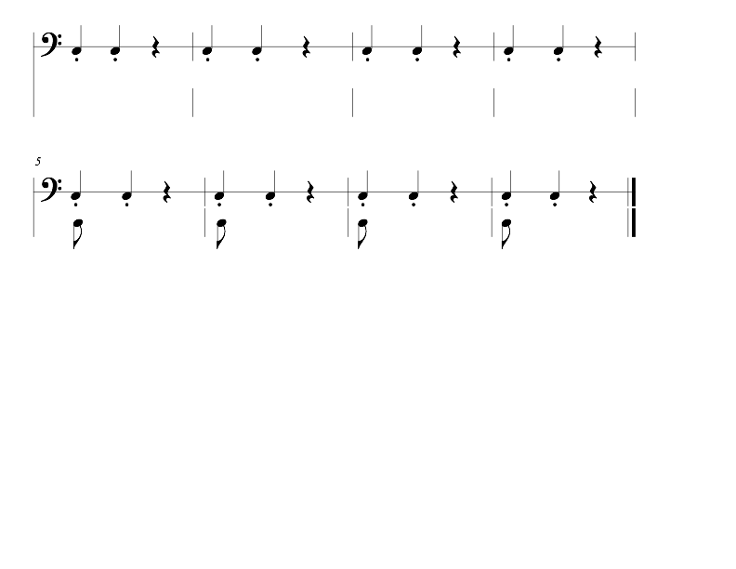
Real Heart - Systolic Murmur

Slide 74
Real Heart - Systolic Murmur

Slide 75
Heart - Diasystolic Murmur

Slide 76
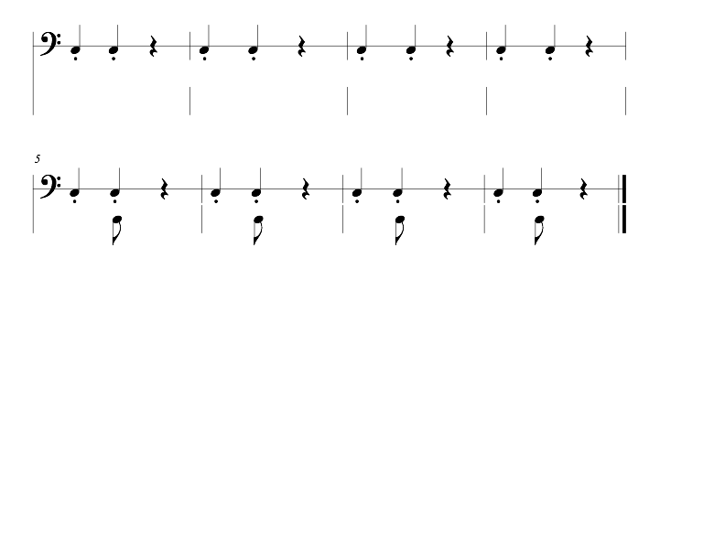
Real Heart - Diasystolic Murmur

Slide 78
Heart - Split S2
S1
S2
S3
S4

Slide 79
Heart - Split S2
Middle
Split S2

Slide 80
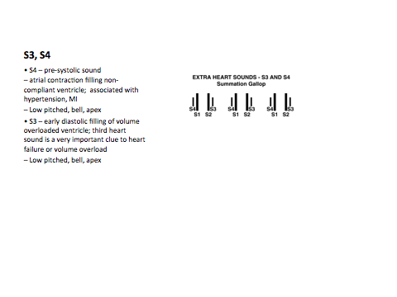

Slide 81
Heart - S3 gallop

Slide 82
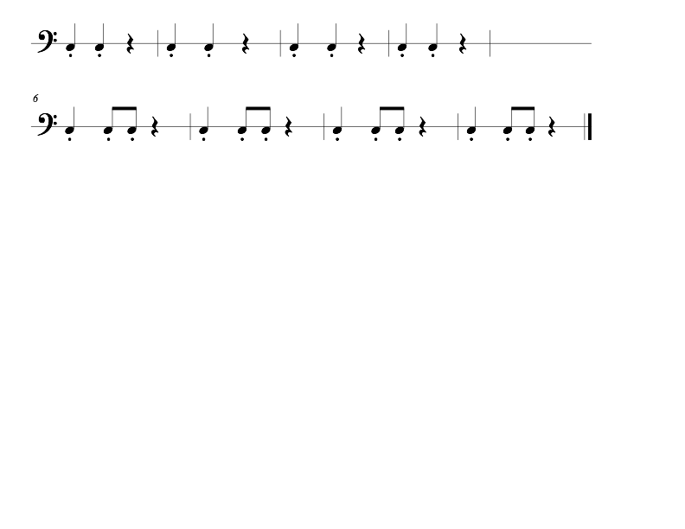
Real Heart - S3 gallop
Middle
S3 gallop

Slide 83
Real Heart - S3 gallop
Middle
S3 gallop

Slide 84
Real Heart Sounds
Example 1:
a. Systolic Murmur
b. Split S2
c. S4 gallop
d. Diastolic murmur
e. Intermittent S4
f. S3 gallop

Slide 85
Real Heart Sounds
Example 2:
a. Systolic Murmur
b. Split S2
c. S4 gallop
d. Diastolic murmur
e. Intermittent S4
f. S3 gallop

Slide 86
Real Heart Sounds
Example 3:
a. Systolic Murmur
b. Split S2
c. S4 gallop
d. Diastolic murmur
e. Intermittent S4
f. S3 gallop

Slide 87
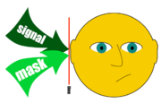
Masking
Auditory masking occurs when the perception of one sound is affected by the presence of another sound.
The brain has filters (auditory filters or critical band widths) that allow us to distinguish one sound from another. (eg. identifying one voice from the background murmur at a party or hearing the lung’s smallest aberrations while ignoring the heart beat.

Slide 88
Butterflies and Bees!
Listen for the cricket!
https://www.youtube.com/watch?v=6dHyxFPp_Ho

Slide 89
Butterflies and Bees!
Listen for the cricket!

Slide 90
Butterflies and Bees!
Listen for the bongos and snare drum.
What is their rhythm?

Slide 91
Masking Games.
What do you hear?
Example 1. WHAT DO YOU HEAR?
A. Normal bowel, normal lung + diastolic murmur?
B. Normal bowel, normal heart + wheeze?
C. Normal bowel + split S2 + friction rub?
D. Normal lung, normal heart, hyperactive bowel?

Slide 92
Masking Games.
What do you hear?
Example 1. WHAT DO YOU HEAR?
Answer:
All normal
A. Normal bowel, normal lung + diastolic murmur?
B. Normal bowel, normal heart + wheeze?
C. Normal bowel + split S2 + friction rub?
D. Normal lung, normal heart, hyperactive bowel?

Slide 93
Masking Games.
What do you hear?
Example 1. WHAT DO YOU HEAR?
Answer:
All normal

Slide 94
 | Number of Sounds | Baseline |  | Post education |  | % Improvement | Wilcoxon signed rank
 |  | Mean Score | % | Mean Score | %
Correctly identified organ (heart, lung or bowel combined) | 25 | 21.78 | 87.12 | 23.39 | 93.56 | 7.39 | 0.0051
Correctly identified specific organ sound | 25 | 4.91 | 19.64 | 10.65 | 42.60 | 116.90 | <.0001
Correctly identified specific heart sound | 10 | 0.96 | 9.60 | 3.48 | 34.80 | 262.50 | <.0001
Correctly identified organ as lung | 10 | 9.04 | 90.40 | 9.56 | 95.60 | 5.75 | .0418
Correctly identified specific lung sound | 10 | 2.04 | 20.40 | 4.26 | 42.60 | 108.82 | .0003
Correctly identified organ as bowel | 5 | 3.39 | 67.80 | 4.48 | 89.60 | 32.15 | .0038
Correctly identified specific bowel sound | 5 | 1.91 | 38.20 | 2.91 | 58.20 | 52.36 | 0.0117

Slide 95
Specifics
Sound | Percent properly identifying sound |  | % Improvement
 | N - Pre test (N-23) | Post test (N-23_
Systolic murmur | N-0; 0% | N-7 30.43% | 30.43%
Diastolic murmur | N-0; 0% | N-16 69.57% | 69.57%
S4 | N-1; 4.35% | N-12 52.7% | 50%
Normal breath sounds | N-0; 0% | N-13 56.52% | 56.52%
Stridor | N-2; 8.70% | N-13 56.52% | 52.38%
Whispered pectoriloquy | N-0; 0% | N-11 47.83% | 47.83%
Normal bowel sound | N- 4; 17.39 % | N-10 43.48 % | 36.84%
Hypoactive bowel sounds | N-9; 39.13 % | N-19 82.61% | 85.71%
Notes:
)]. Results revealed minimal accuracy in lung sound interpretation; wheezes which were interpreted most frequency were only correctly deduced 52.1% of the time, whereas fine crackles were correctly interpreted only 2.1%.
In Mangione’s (2001) study of medical residents in the United States [US], Canada and England, correct interpretation of 12 cardiac sounds was made 22%, 26%, and 20% of the time, respectively. Perhaps more concerning is evidence that only one quarter of US residencies in internal medicine and family practice (Mangione, 1998), and 37.1% of cardiology programs (Mangione, Nieman, Gracely, & Kaye, 1993) provided formal training in cardiac auscultation despite trainees request for this teaching. Researchers suggest the low emphasis on cardiac examination is related to an over-reliance in expensive technology, decreased incidence of valvular diseases in Western world (Bisno, 1987)
26.3%

Slide 96
The future
The humanities are a valuable element of nursing education, yet the type of “humanities” has been constrained in nursing education. Our research reveals that arts and music bring a new lens through which students can learn valuable skills.

Slide 97
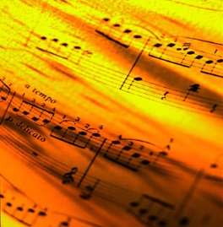
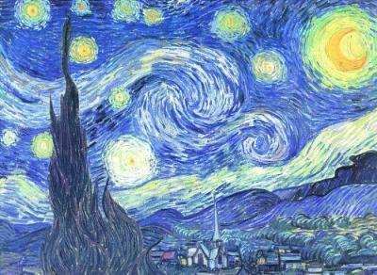
Art work images from Yale Center for British Art and LACMA
Patient Photographs from Charles Goldberg, and Jan Thompson, UCSD and personal photographs
This research was supported by Sigma Theta Tau Int., National League for Nursing, Johnson & Johnson/Global Alliance for Arts & Health Partnership to Promote the Arts in Healing; Robert Wood Johnson

