Slide 1
Being a Nurse
The Lived Experience of Accelerated Second Degree BSN Nurses
Lisa Hennessy, PhD, MSN, RN, CRRN

Slide 2
Significance
Literature has addressed ASD-BSN program design, students, faculty, and new graduates
Existent literature has not addressed ASD-BSN prepared graduates beyond their academic and transition to practice experiences

Slide 3
Research Design
Hermeneutical Phenomenological Study
Heideggarian Philosophy (1962)
Benner’s Interpretive Phenomenological Methodology (1994)
Cohen, Kahn, and Steeves Interpretive Phenomenological Methodology (2000)
Aimed at exploring the lived experience of ASD-BSN prepared nurses engaged in nursing practice
Key Methodology Considerations
Interpretation occurs within the context of the phenomenon
Researcher held assumptions must be articulated in advance
Assumptions are held as tentative and challengeable

Slide 4
Research Question
What is the lived experience of ASD-BSN prepared nurses engaged in professional nursing practice beyond the new graduate phase?

Slide 5
Background
Background
Nursing Shortage
Exploded in the last decade
500,000 nurses short by 2025
Proliferation of ASD-BSN programs
30 in 1990, 130 in 2005
230 in 2010
Designed for rapid workforce entry of persons with non-nursing degrees who desire a career change

Slide 6
Researcher’s World View: Who am I and What do I Believe?
RN with 31 years of experience
Staff nurse
Charge nurse
Nurse administrator
Nurse educator
Informed by Benner’s (1984) Novice to Expert theory
ASD-BSN programs are a successful strategy
ASD-BSN prepared nurses progress is consistent with Benner’s (1984) theory
ASD-BSN nurses will help address the nursing shortage
Participants able to articulate their lived experience

Slide 7
Sampling Process
Inclusion Criteria
-Nurses for 2-7 years
*Competent/Proficient
-2 years in first degree field
Exclusion Criteria
-did not do nursing straight from first degree
-did not graduate from my program
CNO’s/
Hospitals
Faculty Colleagues
Alumni Director
RWJ Colleague
Former Program Director
1
0
1
1
1
4
1
2
3
2
3
1
2

Slide 8
Sample Demographics
12 participants
5 different ASD-BSN programs
7 different communities
75% female, 25% male
Mean age 35
Mean 8 years experience in first degree field
Mean 4 years nursing experience

Slide 9
Interview Process
Informed Consent
Historical Context Question
What brought you to nursing?
Grand Question
You’ve been a nurse for X years now. Please describe your experience as an ASD-BSN prepared nurse.
Follow Up Questions/Probes Determined by Conversation
Final Question
Interviews lasted 50-90 minutes
$30 Pre-paid Visa Card

Slide 10
Data Analysis/Saturation
Listened to interview
Within 24-36 hours
Transcribed interview
Preferably before next interview
Numbered lines
Iteratively read transcriptions
Coded
Emergent understandings
Data Matrix
Spreadsheet
Cells with line numbers
Codes and Participants
Stories
Created narratives

Slide 11
 |  | Rolling River
Always a |  | 158-159, 198-199 |  | 17-21, 31-32, 44 |  | 204-205, 207-215, |  | 39-44, 155-156, |  | 20-22, 101, 103-104, |  | 47-50, 56-57, 91, |  | 9, 10, 11, 204, |  | 95-96, 368-369, |  | 117, 121,122,137 |  | 6-7, 15-17, 20-22 |  | 114-115 |  | 23-25, 35-38, |  | Always a
Nurse |  | 209-210 |  | 46, 121-122, 208- |  | 245-247 |  | 188-191 |  | 150, 155, 165-166, |  | 99, 186, 247, 362 |  | 218 |  | 376-377, 382 |  |  |  | 34, 79-82, 119-120, |  |  |  | 246-247, 280, |  | Nurse
 |  |  |  | 209, 211, 257, |  |  |  | 200-202, 203-204, |  | 212-215 |  |  |  |  |  |  |  |  |  | 144-145 |  |  |  | 288, 290-291,
 |  |  |  | 259-266, 271-276, |  |  |  | 209, |  |  |  |  |  |  |  |  |  |  |  |  |  |  |  | 314-315
 |  |  |  | 287, 298, 313-316
Being a Nurse |  | 84-85, 109-110, |  | 184-188, 190, 219- |  | 251-260 |  | 83-85, 155-163, |  | 66-67, 76, 136, |  | 99-101, 341-347 |  |  |  | 166-167, 177-178, |  | 162, 164, 182, 188 |  |  |  | 188-189 |  | 113-121, 292-294, |  | Being a Nurse
 |  | 114-116, 129-130 |  | 220, 271, 276, |  |  |  | 183-186, 211-213 |  | 155-156 |  |  |  |  |  | 188-196, 221, 222, |  | 438 |  |  |  | 193-195 |  | 322-323, 341
 |  | 161-164, 172-174 |  | 278-280 |  |  |  |  |  |  |  |  |  |  |  | 229-232
Past as Present |  | 156-157, 211, |  | 247-254 |  | 26-27, 89-91 |  | 37, 49-51, 55-56, |  | 189 |  | 249-254, 308-313 |  | 220, 223, 226, 228, |  | 245-246, 249, 268, |  | 129, 135, 144, 476 |  | 148, 301-315 |  | 95-97, 113, |  | 28-29, 43-44, |  | Past as Present
 |  | 222-232, 238 |  |  |  | 228-233* |  | 134-136, 194-198 |  |  |  |  |  | 232, 234 |  | 270-271, 281-283, |  |  |  |  |  | 119-121, 215 |  | 48-49, 90-91,
 |  |  |  |  |  |  |  |  |  |  |  |  |  |  |  | 288, 355-357 |  |  |  |  |  | 232-234 |  | 122, 260-271
Teamwork |  | 236, 238, 252, 259, |  | 145-147, 230-232, |  | 45-52, 56-60, |  | 132, 173-178 |  | 57, 67-69, 79-82 |  | 24-26, 257, 262 |  | 111, 112, 184, 186, |  | 70, 214-216, 243, |  | 322,344, 390-391, |  | 207-210, 258 |  | 172-177 |  | 54-59, 88, |  | Teamwork
 |  | 262-264, 266-267* |  | 150-152 |  | 62-66, 75, 124*, |  | 180, 238-240 |  |  |  |  |  | 193-196, 220-221 |  | 260-261, 339-342 |  |  |  |  |  |  |  | 138-141, 175-177,
 |  |  |  |  |  | 187-190 |  |  |  |  |  |  |  | 226-227 |  |  |  |  |  |  |  |  |  | 337-338
Emotions |  | 58-59*, 136-137 |  | 100, 120, 366-367 |  | 280 |  | 68-70, 75-78, |  | 91, 101, 134, 142, |  | 27-28, 36-64, 74 |  | 60, 66, 230, 231, |  | 73, 98, 99, 106, |  | 16, 102, 169, 170, |  | 318-320, 332-334 |  | 60-63, 106-107, |  |  |  | Emotions
Nurturing Through |  | 143-144*, 269- |  |  |  |  |  | 80-82, 90-94 |  | 192-193 |  |  |  | 259, 266 |  | 110-111, 113-120, |  | 246, 328, 343, |  |  |  | 114-115 |  |  |  | Nurturing Through
Caring |  | 270, 326-328* |  |  |  |  |  |  |  |  |  |  |  |  |  | 137-139, 182-185, |  | 424-425, 465 |  |  |  |  |  |  |  | Caring
 |  |  |  |  |  |  |  |  |  |  |  |  |  |  |  | 216, 236, 238, 266,
 |  |  |  |  |  |  |  |  |  |  |  |  |  |  |  | 297, 316-320, 336
Advocacy |  | 178, 180, 185-186 |  | 169-177, 257 |  |  |  | 156-165 |  | 8-10, 135, 181 |  | 69-73, 47, 129, |  | 95 |  |  |  | 199-200, 234, |  | 54 |  |  |  | 118-122 |  | Advocacy
 |  |  |  |  |  |  |  |  |  |  |  | 135-139, 142-143, |  |  |  |  |  | 241-243, 262,
 |  |  |  |  |  |  |  |  |  |  |  | 170-171 |  |  |  |  |  | 267, 439
Power |  | 146-147*, 182, 185- |  | 116-117, 120 |  | 62-66 |  |  |  |  |  | 14, 26, 53, 73, |  | 84, 86, 117, 130- |  | 84, 85, 97 |  | 235 |  | 92-97, 132-133 |  | 142-144, 149 |  |  |  | Power
 |  | 186, 241-255, 296- |  |  |  |  |  |  |  |  |  | 94-97, 107-108, |  | 136, 139, 144, 147
 |  | 297 |  |  |  |  |  |  |  |  |  | 118-120, 174-175 |  | 163, 168
 |  |  |  |  |  |  |  |  |  |  |  | 181-184, 188-189,
 |  |  |  |  |  |  |  |  |  |  |  | 237-238, 285, 288
 |  |  |  |  |  |  |  |  |  |  |  | 297-298
Best Thing Ever |  | 325, 331, 333, |  | 136-137, 89, 116- |  | 136, 236, 279 |  | 106, 215-216, 222, |  | 28, 31-34, 233, |  | 16, 45, 76-77, |  | 32, 40, 72, 98-100, |  | 7, 71, 82, 97, |  | 68, 213, 214, 386, |  | 42, 60, 127, 348, |  | 72-75, 239, 240 |  | 318-320, 357, 404 |  | Best Thing Ever
I love it |  | 341, 342 |  | 117, 119, 146, |  |  |  | 257 |  | 235-236, 267-270 |  | 361-363 |  | 207, 237, 272-273 |  | 276-277, 278, 303 |  | 420-423, 428, 444, |  | 357-359 |  | 241, 244 |  |  |  | I love it
Instrinsic Rewards |  | *contrary case |  | 287-288, 333-334 |  |  |  |  |  |  |  |  |  |  |  |  |  | 493-494 |  |  |  |  |  |  |  | Instrinsic Rewards

Slide 12
Stories
Altruism/Wanting to Help/Spirituality
I have a history of volunteer work, I’ve always felt like that was very important. I had gone to Hurricane Katrina with the Red Cross and I worked with the Red Cross in wildfires and various other things but when I went to Katrina, it was such a huge disaster and there was so much of a need, especially for the medical field. [Another thing I did] before I got into nursing was big brothers/big sisters. [I am also] very interested in animal rescue, I have a big history in animal rescue and animal type activities. [I have volunteered with things like] the local humane society, the humane society of the United States, ASPCA. And, when I was working in the English field, I did volunteer service and I taught ESL. [So, I] became very taken with the idea of helping people who were in dire need of any kind of medical assistance. I spent almost a year in the ED [as a student] and I decided that there was a huge need in the mental health field and there are not a lot of people who want to do it.
--Kristin Lines 4, 20, 26, 5, 35, 160, 185

Slide 13
Rigor
Reflexive Journal
Notes on process
Notes on interviews
Preliminary understandings
Copies of my marked up transcripts
Serial copies of the data matrix
Serial copies of the stories
Audit Trail

Slide 14
Hennessy’s River System Model of ASD-BSN Nursing Practice
The Themes and Sub-Themes

Slide 15
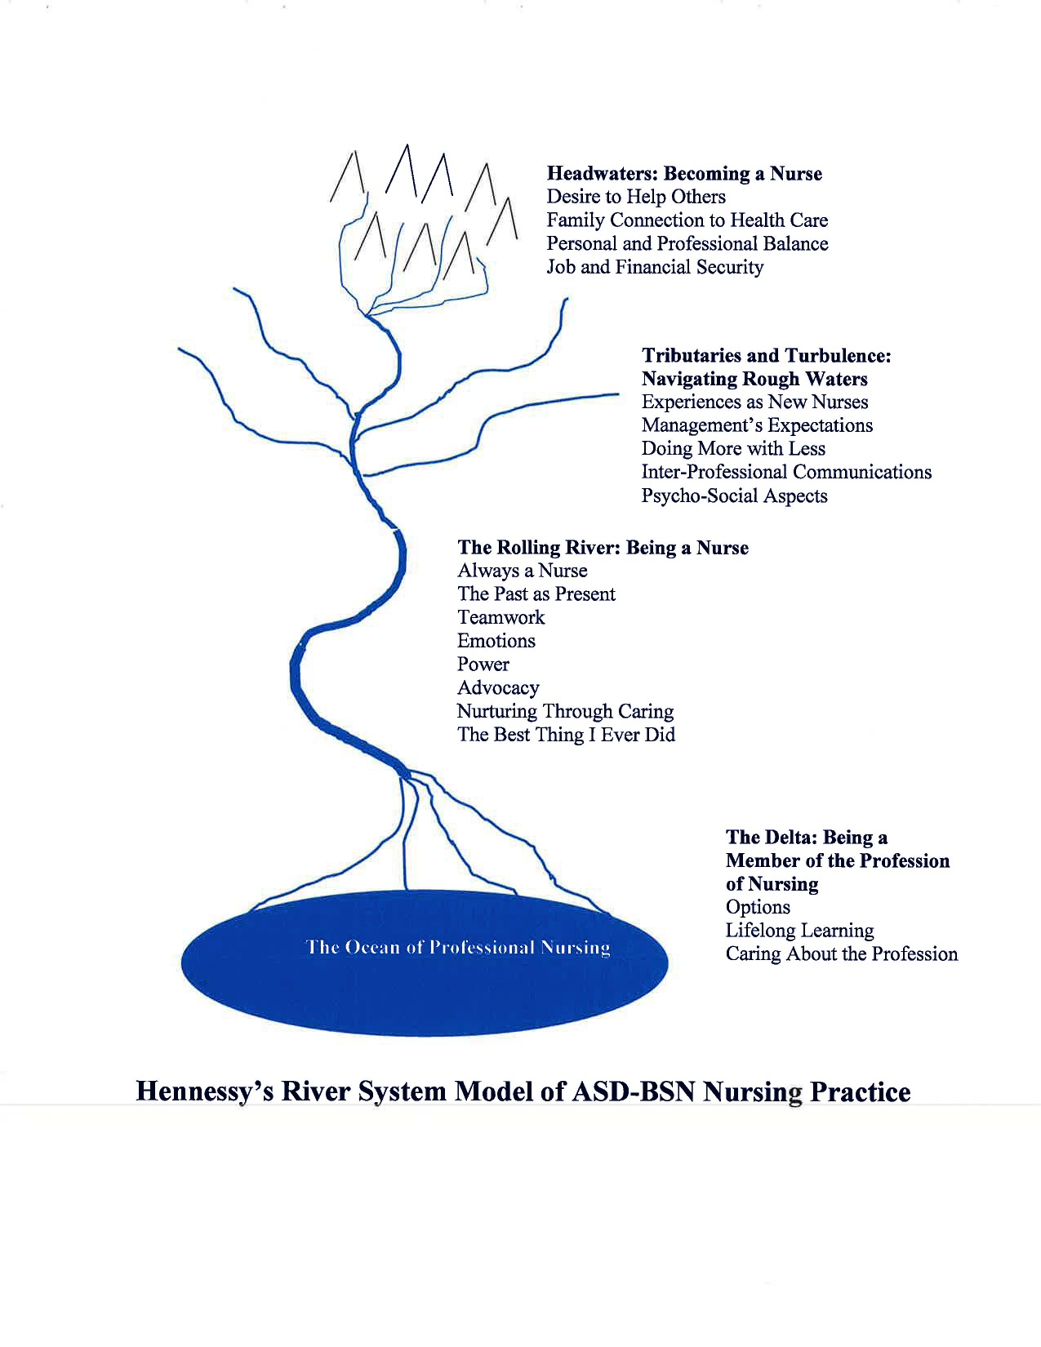
© Lisa Hennessy, 2012

Slide 16
The Paradigm Case of the ASD-BSN Educated Nurse
ASD-BSN prepared nurses are just that – nurses
Drawn to nursing and experience nursing in much the same manner as nurses educated in other types of programs
Are better able to deal with challenges by virtue of their previous careers and professional maturity
Consider themselves to be members of a honored and trusted profession
Well socialized into the profession of nursing

Slide 17
Implications
Nursing Education
Programs need to continue
Address nursing shortage
Provide rapid work-force entry
Nursing Administration
Individualized orientations
To capitalize on professional maturity and previous skills sets
Don’t compromise on the basis of professional maturity
Recognize likelihood of rapid professional advancement
Nursing Practice
Track this population of nurses in order to study their impact

Slide 18
Limitations
My inexperience in phenomenological research
Qualitative studies lack generalizability
Solicitation of participants and voluntary participation may have excluded
Those who have left nursing
Those who are unhappy in nursing

Slide 19
Areas of Future Research
ASD-BSN nurses’ career trajectories, educational accomplishments, longevity in the profession
Develop/adapt instruments to measure attributes of model

Slide 20
Thank you
Questions????

