Slide 1
Plenary Session: PIP On-Line
Kenya Snowden DNP, Adult/ACNP-BC
Lyndon Godsall Ed.D, Ed.S, M.Ed,
University of Miami
School of Nursing and Health Studies

Slide 2
BSN Accelerated Program
Launched in May 2004, the accelerated BSN program was developed to
address our nation’s nursing shortage. Applicants to the 12-month, full-time program must hold baccalaureate degrees; however, many also hold graduate degrees and/or have many years of professional experience in health-related or other relevant professions, providing us with a highly diverse and educated applicant pool.

Slide 3
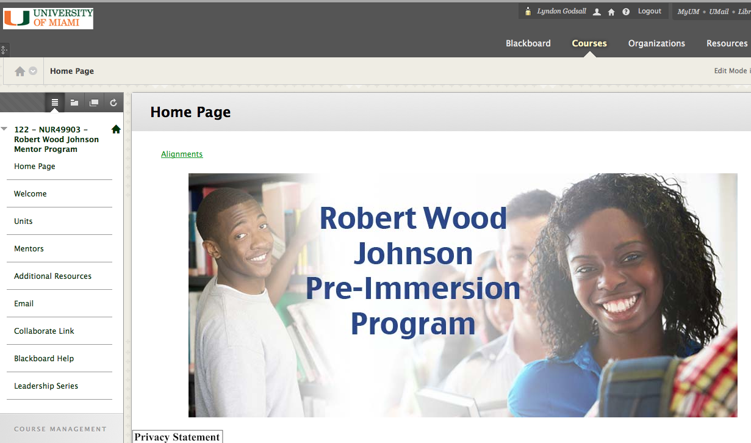

Slide 4
Preparation

Slide 5
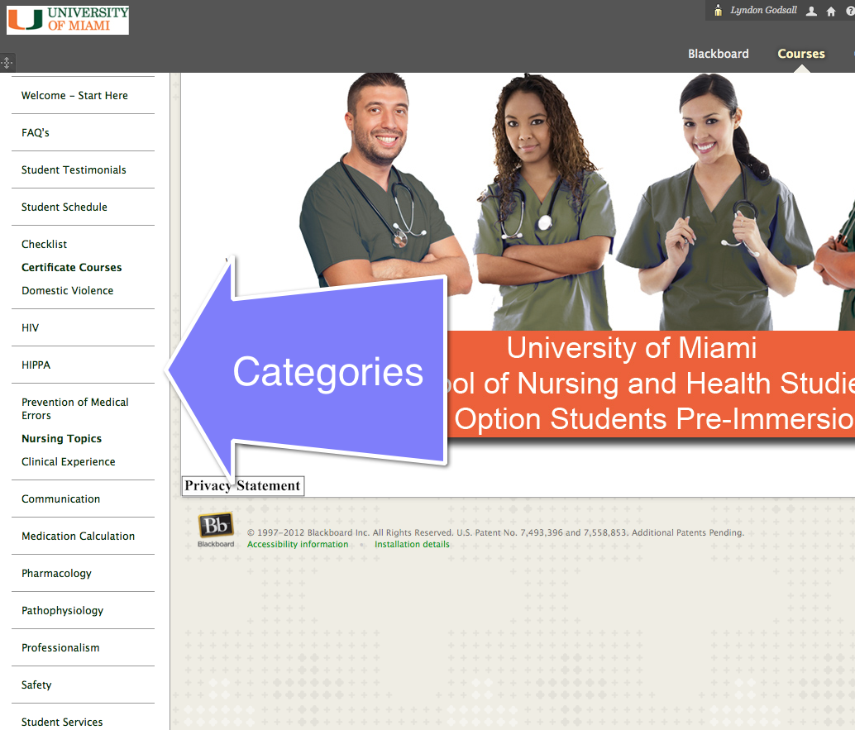

Slide 7
Collaborate

Slide 8
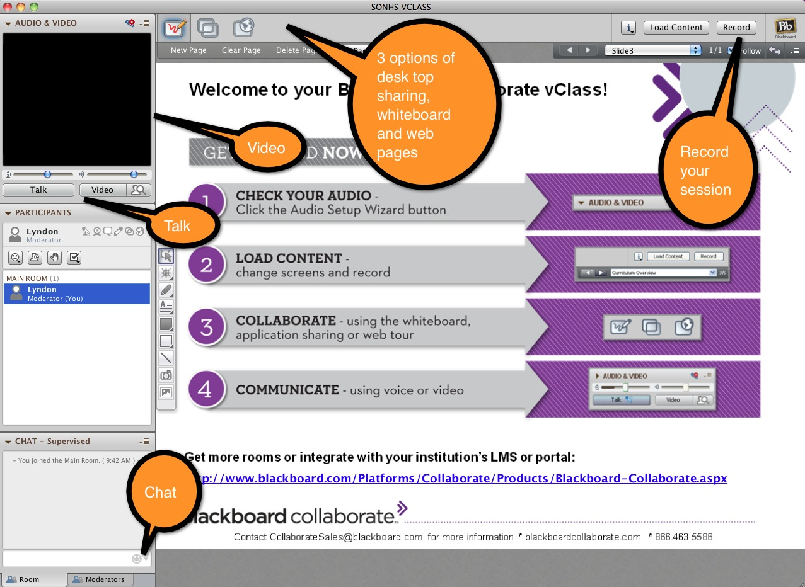

Slide 9
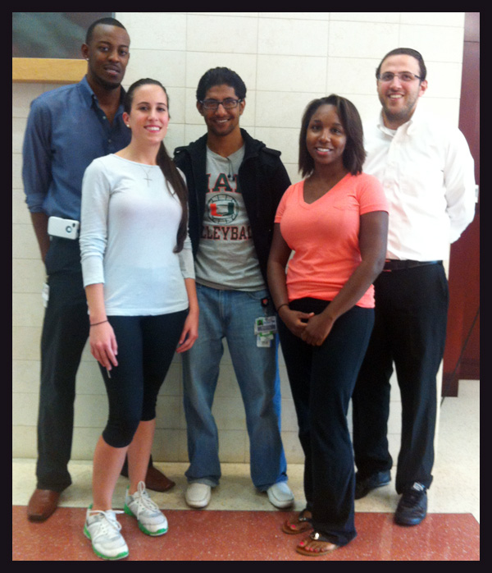

Slide 10
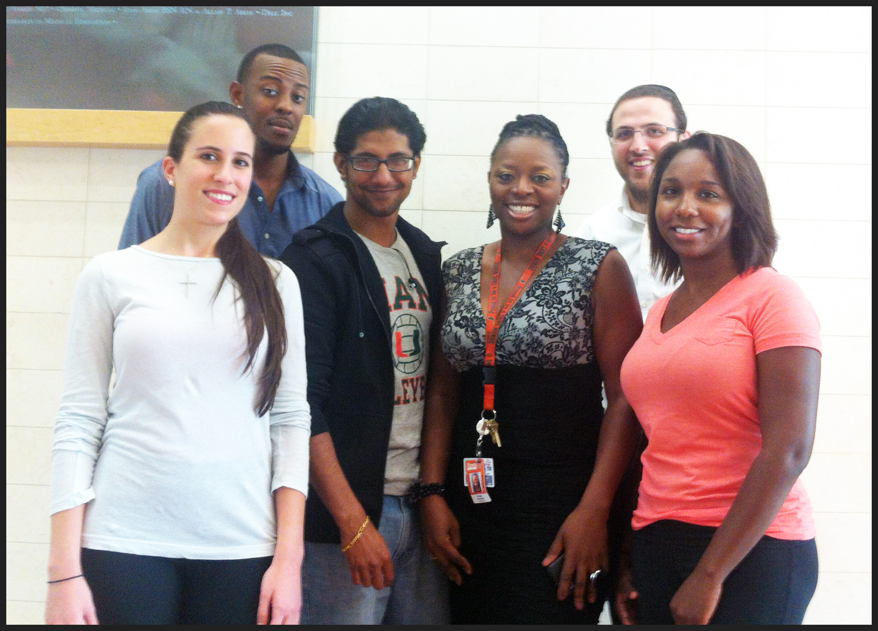
We had regular weekly meetings with the students who were scattered across the country.

Slide 11
Student Feedback
Great way to network
Building Bridges
Felt like we had
already begun

Slide 12
Students were already an established group when they arrived on campus. They already knew someone and bonded as a group.

Slide 13
It was very convenient to use Collaborate. Students and faculty were using a range of computers and devices and had no issues with the technology.

Slide 14
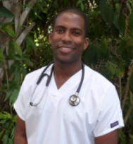
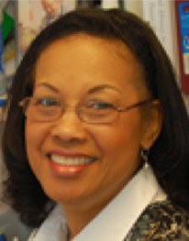
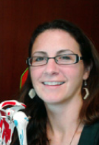
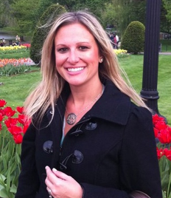
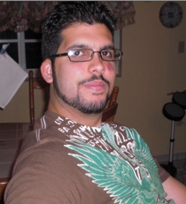
Mentors meet regularly with their mentees and had the option of using Collaborate as an alternative to meeting face to face.

Slide 15
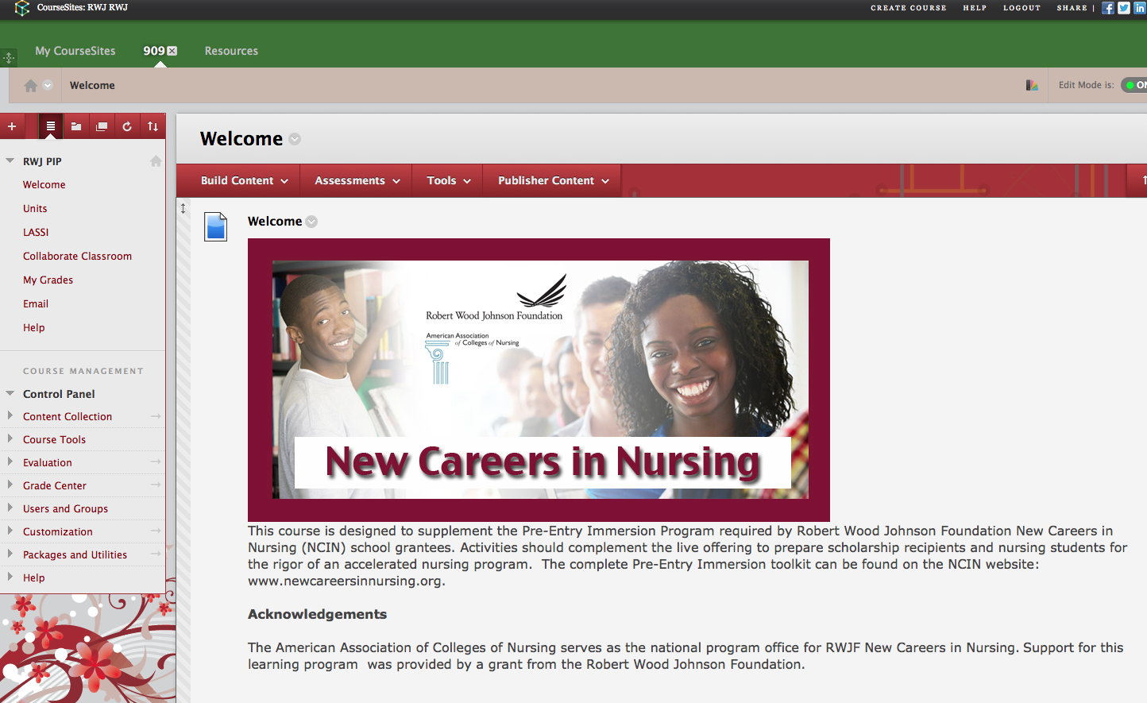

Slide 16
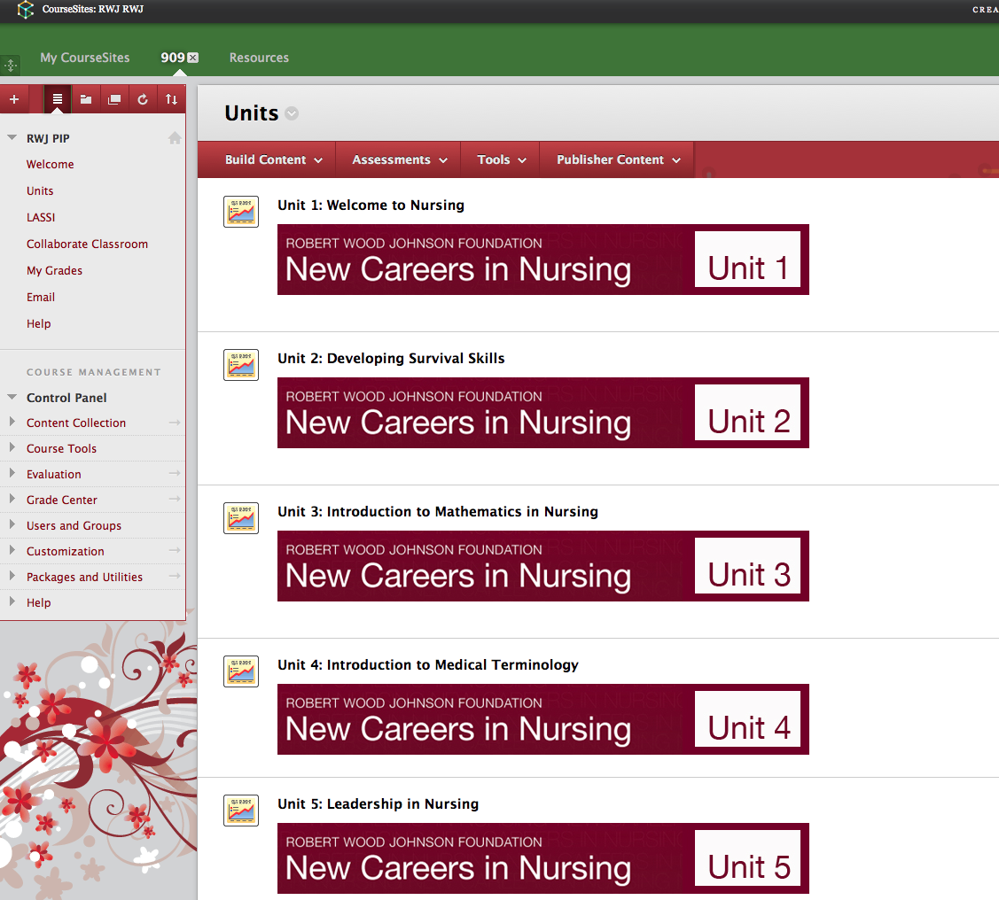

Slide 17
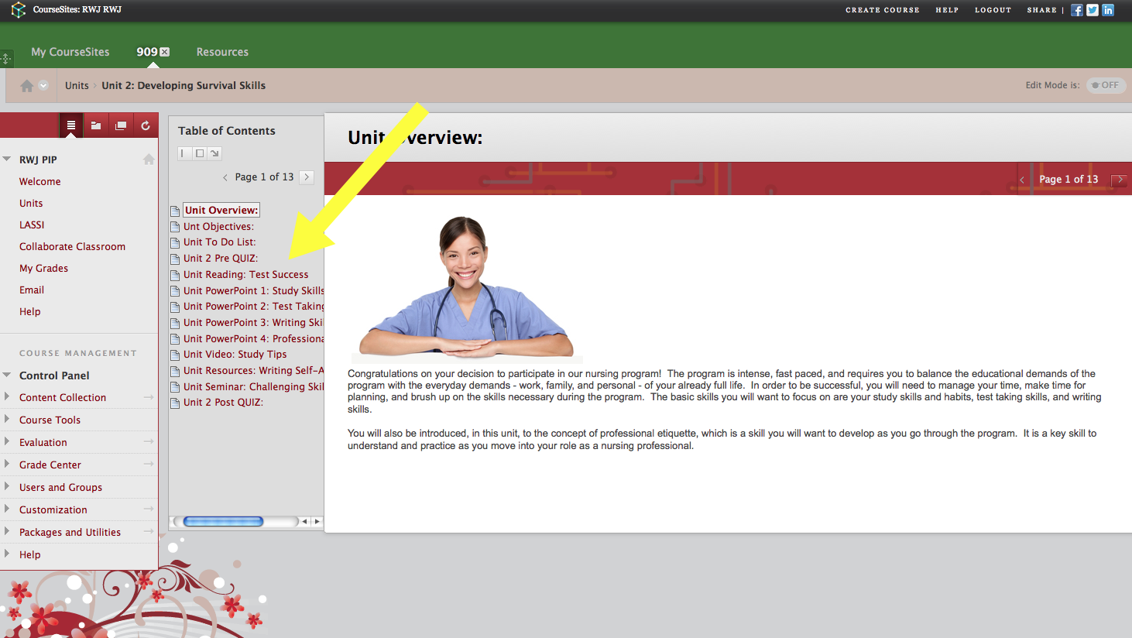

Slide 18
Conclusion
Collaborate and Blackboard has allowed us to do things that were not possible in the past. The technology we have available now allows us to address the U.S. nursing shortage which is projected to reach 260,000 registered nurses by 2025 and will be unrelenting as the aging population is compounded with a shortage in nurse faculty.

Slide 19
Any
Questions?

