Slide 1
2013 NCIN Program Liaisons Summit American Association of Colleges of Nursing Washington, DC October 11, 2013 Catherine M. Millett, Ph.D.
Health & Medical Care Archive
Accessing RWJF Data for Secondary Analysis

Slide 2
http://www.icpsr.umich.edu/icpsrweb/HMCA/index.jsp

Slide 3
Overview of HMCA
Archive of publicly-accessible data supported by the Robert Wood Johnson Foundation.
Preserves and disseminates data collected for selected research projects funded by RWJF.
Operated by the Inter-university Consortium for Political and Social Research (ICPSR) at the University of Michigan.
Goal of increasing understanding of health and health care in the US by facilitating secondary analysis of RWJF-supported data collections.
HMCA provides guidance and technical support in use of data to promote access.

Slide 4
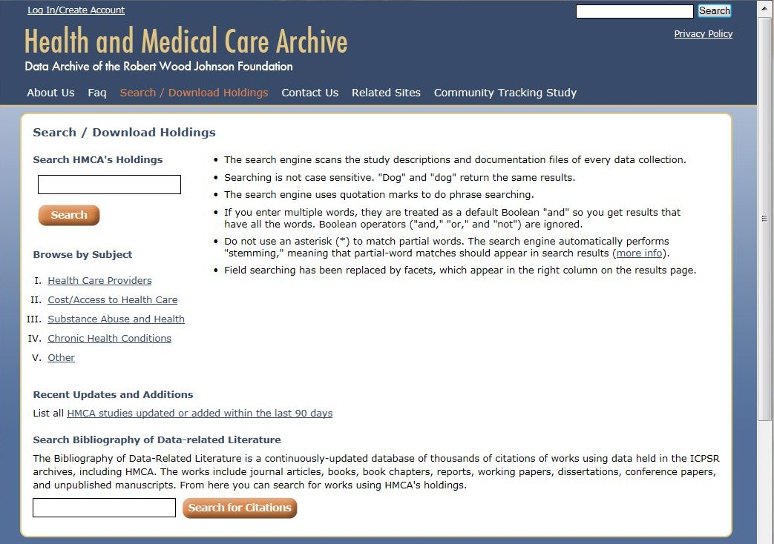
http://www.icpsr.umich.edu/icpsrweb/HMCA/archive.jsp

Slide 5
Five Categories of Health & Health Care Data
Health Care Provides
Cost/Access to Health Care
Substance Abuse & Health
Chronic Health Conditions
Other Research

Slide 6
Notes:
Search for adolescents...

Slide 7
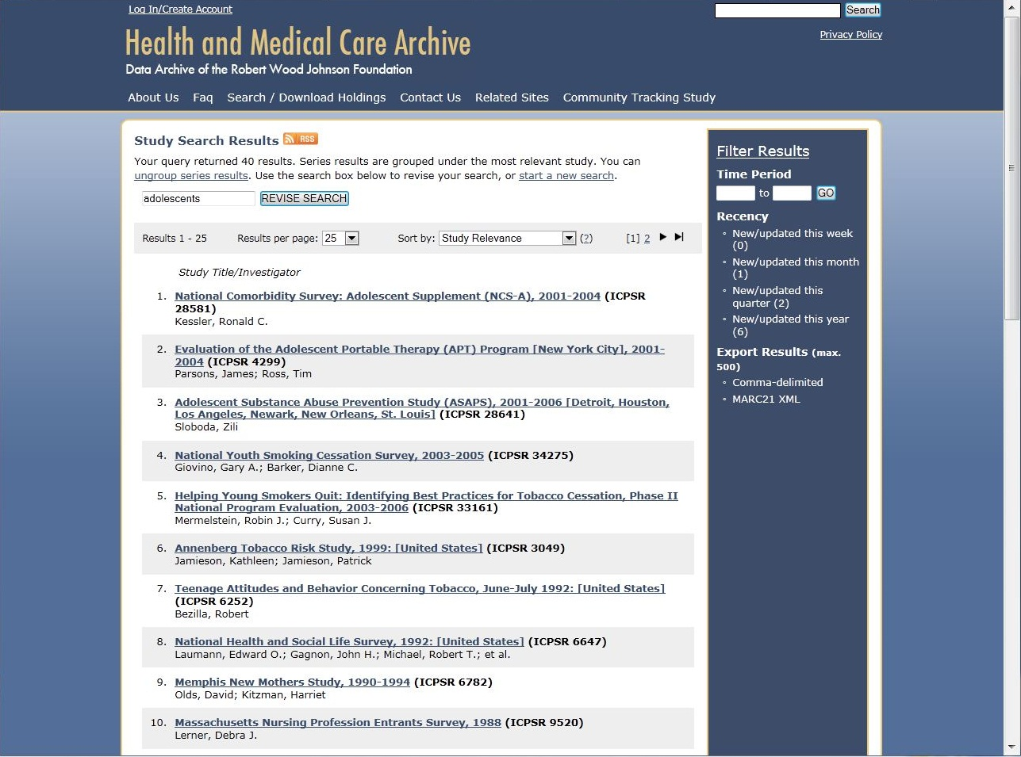
Notes:
Yields 40 results in HMCA database

Slide 8
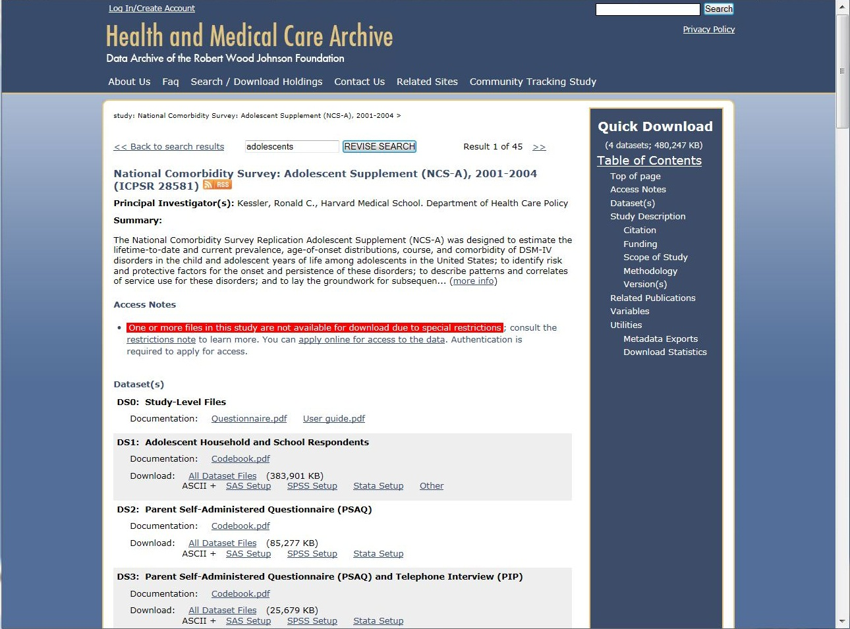
Notes:
Select first result to view study details:
Study Description
Citation
Kessler, Ronald C. National Comorbidity Survey: Adolescent Supplement (NCS-A), 2001-2004. ICPSR28581-v5. Ann Arbor, MI: Inter-university Consortium for Political and Social Research [distributor], 2013-08-28. doi:10.3886/ICPSR28581.v5
Persistent URL: http://doi.org/10.3886/ICPSR28581.v5
Export Citation:
RIS (generic format for RefWorks, EndNote, etc.)
EndNote XML (EndNote X4.0.1 or higher)
Funding
This survey was funded by:
United States Department of Health and Human Services. National Institutes of Health. National Institute of Mental Health (U01-MH60220)
United States Department of Health and Human Services. National Institutes of Health. National Institute of Drug Abuse (R01-DA12058-05)
United States Department of Health and Human Services. Substance Abuse and Mental Health Services Administration
Robert Wood Johnson Foundation (Grant 044780)
John W. Alden Trust
Scope of Study
Subject Terms: adolescents, health services utilization, mental disorders, mental health, mental health services, parents, psychiatric services, young adults
Geographic Coverage: United States
Time Period:
2001-02--2004-01
Date of Collection:
2001-02--2004-01
Unit of Observation: individual
Data Types: survey data
Data Collection Notes:
ICPSR processing notes have been added to the User Guide.
The Codebook for Dataset 1 (Adolescent Household and School Respondents) is provided in two formats: PDF and HTML. The latter is supplied as a series of HTML files in a ZIP archive. In the ZIP archive, the file named Contents.html is the "homepage" with links to the other HTML files.
ICPSR generated the SAS, SPSS, and Stata setups and the ASCII, SPSS, and Stata versions of the data from the original SAS files provided by the principal investigator. The SAS special missing value codes D and R in the SAS files were recoded in the ASCII and SPSS data files: D was recoded to 8, 98, 998, or 9998 depending on the size of the variable, and R was recoded to 9, 99, 999, or 9999. In addition, the SAS missing value code denoted by a single period (.) was recoded to blank field in the ASCII data files and to the SPSS system missing value in the SPSS data files.
Only the SAS data files include value labels for the top and bottom codes (e.g., "20 or more" and "5 and under"). These labels are not included in the SPSS and Stata data files or the SAS, SPSS, and Stata setups.
Methodology
Sample: NCS-A was originally designed to obtain the sample of adolescents from those residing in National Comorbidity Survey- Replication (NCS-R) households. However, the number of such youths was too small to generate the target sample of 10,000 respondents. Consequently, the households sample was supplemented by adding a school-based sample, leading to a dual frame design. One sample was recruited from the NCS-R households and the other from a representative sample of schools in the same communities as the NCS-R households. All schools (public and private, schools for gifted children, therapeutic schools, etc.) were included in their true population proportions. A stratified probability sample of students was selected from each school to participate in the survey.
You can find more information via the sample characteristics utility:
Weight: The data were weighted for within household probability of selection (only in the household sample) and for residual discrepancies between the sample and population on a wide range of census sociodemographic and geographic variables. Please refer to the user guide to obtain weighting information for each part.
Mode of Data Collection: computer-assisted personal interview (CAPI), computer-assisted telephone interview (CATI), telephone interview
Response Rates:
The response rate of adolescents in the household sample was 85.9 percent, yielding 904 interviews, conditional (on adult participation in the NCS-R).
The response rate of adolescents in the school sample was 74.7 percent, yielding 9,244 interviews.
Extent of Processing: ICPSR data undergo a confidentiality review and are altered when necessary to limit the risk of disclosure. ICPSR also routinely creates ready-to-go data files along with setups in the major statistical software formats as well as standard codebooks to accompany the data. In addition to these procedures, ICPSR performed the following processing steps for this data collection:
Performed consistency checks.
Version(s)
Original ICPSR Release: 2011-07-27
Version History:
2013-08-28 Variable RESPGENDER (Respondent's Gender) in Dataset 1 (Adolescent Household and School Respondents) has been corrected. The previous version of this variable had incorrect values for 1,034 cases.
2011-10-24 The setup files and documentation were added to the restricted release. Those files were already available through the public release.
2011-10-20 The Stata setup and ready-to-go files and the tab-delimited files were released.
2011-10-12 The HTML codebook was changed to be available for public use. Also, the statistical files were replaced because the previous version of the data contained incorrect decimal corrections across statistical packages. The SAS and Stata files were changed so that the original special missing value coding was not lost.
Related Publications (?)
List all ~55 citations associated with this study
List ~39 citations that match your query
Search the citations in this study
Top Publications that Match your Query
2010
Hunt, Justin, Eisenberg, Daniel . Mental health problems and help-seeking behavior among college students. Journal of Adolescent Health. 46, (1), 3-10.
2011
Merikangas, Kathleen Ries, He, Jian-ping, Burstein, Marcy, Swendsen, Joel, Avenevoli, Shelli, Case, Brady, Georgiades, Katholiki, Heaton, Leanne, Swanson, Sonja, Olfson, Mark . Service utilization for lifetime mental disorders in U.S. adolescents: Results of the National Comorbidity Survey?Adolescent supplement (NCS-A). Journal of the American Academy of Child and Adolescent Psychiatry. 50, (1), 32-45.
2013
Olfson, Mark, He, Jian-ping, Merikangas, Kathleen Ries . Psychotropic medication treatment of adolescents: Results from the National Comorbidity Survey-Adolescent Supplement. Journal of the American Academy of Child and Adolescent Psychiatry. 52, (4), 378-388.
2012
McLaughlin, K.A., Greif Green, J., AlegrÃ­a, M., Jane Costello, E., Gruber, M.J., Sampson, N.A., Kessler, R.C. . Food insecurity and mental disorders in a National Sample of US Adolescents. Journal of the American Academy of Child and Adolescent Psychiatry. 51, (12), 1293-1303.
2013
Green, Jennifer Greif, McLaughlin, Katie A., Alegria, Margarita, Costello, E. Jane, Gruber, Michael J., Hoagwood, Kimberly, Leaf, Philip J., Olin, Serene, Sampson, Nancy A., Kessler, Ronald C. School mental health resources and adolescent mental health service use. Journal of the American Academy of Child and Adolescent Psychiatry. 52, (5), 501-510.
2010
Merikangas, Kathleen Ries, He, Jian-ping, Burstein, Marcy, Swanson, Sonja A., Avenevoli, Shelli, Cui, Lihong, Benjet, Corina, Georgiades, Katholiki, Swendsen, Joel . Lifetime prevalence of mental disorders in U.S. adolescents: Results from the National Comorbidity Survey Replication?Adolescent Supplement (NCS-A). Journal of the American Academy of Child and Adolescent Psychiatry. 49, (10), 980-990.
2009
Kessler, Ronald C., Avenevoli, Shelli, Costello, E. Jane, Green, Jennifer Greif, Gruber, Michael J., Heeringa, Steven, Merikangas, Kathleen R., Pennell, Beth-Ellen, Sampson, Nancy A., Zaslavsky, Alan M. National Comorbidity Survey Replication Adolescent Supplement (NCS-A): II. Overview and design. Journal of the American Academy of Child and Adolescent Psychiatry. 48, (4), 380-385.
2009
Merikangas, Kathleen R., Avenevoli, Shelli, Costello, E. Jane, Koretz, Doreen, Kessler, Ronald C. National Comorbidity Survey Replication Adolescent Supplement (NCS-A): I. Background and measures. Journal of the American Academy of Child and Adolescent Psychiatry. 48, (4), 367-369.
2009
Kessler, Ronald C., Avenevoli, Shelli, Green, Jennifer, Gruber, Michael J., Guyer, Margaret, He, Yulei, Jin, Robert, Kaufman, Joan, Sampson, Nancy A., Zaslavsky, Alan M., Merikangas, Kathleen R. National Comorbidity Survey Replication Adolescent Supplement (NCS-A): III. Concordance of DSM-IV/CIDI diagnoses with clinical reassessments. Journal of the American Academy of Child and Adolescent Psychiatry. 48, (4), 386-399.
2011
Burstein, Marcy, He, Jian-Ping, Kattan, Gabriella, Albano, Anne M., Avenevoli, Shelli, Merikangas, Kathleen R. Social phobia and subtypes in the National Comorbidity Survey?Adolescent Supplement: Prevalence, correlates, and comorbidity. Journal of the American Academy of Child and Adolescent Psychiatry. 50, (9), 870-880.
Variables
List all 4528 variables in this study
Search the variables in this study

Slide 9
Accessing HMCA Data
All HMCA data, metadata, and documentation files are available free to the public.
Five data formats: SAS, SPSS, Stata, column-delimited ASCII, and tab-delimited ASCII.
Restricted data access requires an online application and authentication.
Download HMCA Data by logging in:
Establish a MyData account, or
Log in using a Facebook or Google account.

Slide 10
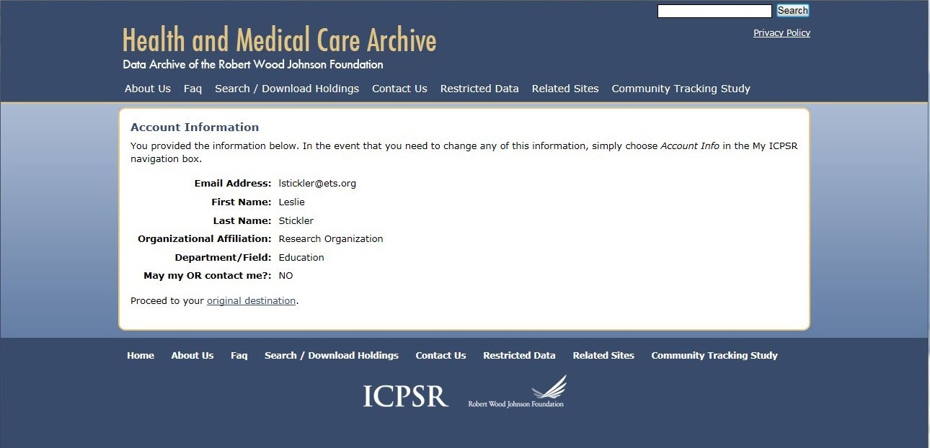
Less Than 2 Minutes to Register
Notes:
My password is aub3rg1n3 (in case you don’t get a chance to sign up prior to the presentation).

Slide 11
Agree to Terms of Use...

Slide 12
And You’ve Got Data!
National Comorbidity Survey: Adolescent Supplement (NCS-A), 2001-2004
National Youth Smoking Cessation Survey, 2003-2005
Healthy Schools Program Evaluation, 2006-2011
Community Partnerships for Older Adults (CPFOA) Program Survey of Older Adults, 2008
Evaluation of Better Jobs Better Care: Direct Care Worker Survey, 2004-2007
Notes:
Datasets were chosen from five categories of HMCA data, 2005 – present. Right click and selecting open will lead to the page of individual dataset.

Slide 13
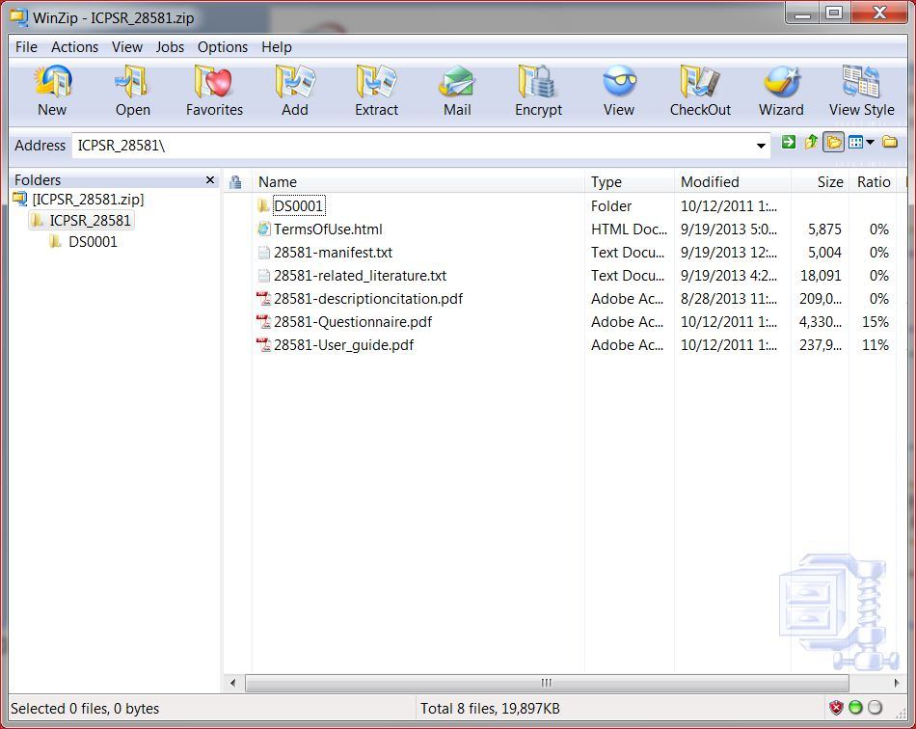

Slide 14
Resources & Documentation
Summary
Access notes
Datasets to download
Export citation (EndNote)
Funding sources
Subject terms
Geographic coverage
Time period
Date of collection
Unit of observation
Data types
Data collection notes
Sample & weights
Mode of data collection
Response rates
Data processing
Version history
Related publications
Most recent publications
List of variables (4528)
Metadata exports
Statistics/usage of study
Notes:
National Comorbidity Survey: Adolescent Supplement (NCS-A), 2001-2004 (ICPSR 28581)
Principal Investigator(s):Kessler, Ronald C., Harvard Medical School. Department of Health Care Policy
Summary:
The National Comorbidity Survey Replication Adolescent Supplement (NCS-A) was designed to estimate the lifetime-to-date and current prevalence, age-of-onset distributions, course, and comorbidity of DSM-IV disorders in the child and adolescent years of life among adolescents in the United States; to identify risk and protective factors for the onset and persistence of these disorders; to describe patterns and correlates of service use for these disorders; and to lay the groundwork for subsequen... (more info)
The National Comorbidity Survey Replication Adolescent Supplement (NCS-A) was designed to estimate the lifetime-to-date and current prevalence, age-of-onset distributions, course, and comorbidity of DSM-IV disorders in the child and adolescent years of life among adolescents in the United States; to identify risk and protective factors for the onset and persistence of these disorders; to describe patterns and correlates of service use for these disorders; and to lay the groundwork for subsequent follow-up studies that can be used to identify early expressions of adult mental disorders.
In addition to interviewing adolescents, information was collected from a parent or a parent surrogate to obtain an additional perspective on the adolescent's mental health and its correlates. Information from parents focused on the five adolescent disorders for which previous methodological research has most consistently shown that parental reports are important for making diagnoses: attention-deficit/hyperactivity disorder, conduct disorder, oppositional defiant disorder, major depressive episode, and dysthymic disorder.
The study contains four data files: (1) data for the adolescent household and school respondents; (2) data for the parents who responded to the long self-administered questionnaire; (3) data for the parents who responded to both the long self-administered questionnaire and the short telephone interview; and (4) diagnostic variables based on information collected from both adolescents and parents.
Demographic information includes age, citizenship status, country of birth, criminal history, ethnicity, grandparents' country of birth, language(s) spoken in the home, parents' country of birth, race, religion, and sex.
Access Notes
One or more files in this study are not available for download due to special restrictions; consult the restrictions note to learn more. You can apply online for access to the data. Authentication is required to apply for access.
The data files are restricted from general dissemination for reasons of confidentiality. Users interested in obtaining these data must complete an Agreement for the Use of Confidential Data, specify the reasons for the request, and obtain IRB approval or notice of exemption for their research. Apply for access to these data through the ICPSR restricted data contract portal, which can be accessed via the study home page.
Dataset(s)
DS0: Study-Level Files Documentation:
Questionnaire.pdfUser guide.pdf
DS1: Adolescent Household and School Respondents Documentation:
Codebook.pdf
Download:
All Dataset Files (383,901 KB) ASCII + SAS SetupSPSS SetupStata SetupOther
DS2: Parent Self-Administered Questionnaire (PSAQ) Documentation:
Codebook.pdf
Download:
All Dataset Files (85,277 KB) ASCII + SAS SetupSPSS SetupStata Setup
DS3: Parent Self-Administered Questionnaire (PSAQ) and Telephone Interview (PIP) Documentation:
Codebook.pdf
Download:
All Dataset Files (25,679 KB) ASCII + SAS SetupSPSS SetupStata Setup
DS4: Diagnostic Variables From Both Adolescents and Parents Documentation:
Codebook.pdf
Download:
All Dataset Files (13,137 KB) ASCII + SAS SetupSPSS SetupStata Setup
Study Description
Citation
Kessler, Ronald C. National Comorbidity Survey: Adolescent Supplement (NCS-A), 2001-2004. ICPSR28581-v5. Ann Arbor, MI: Inter-university Consortium for Political and Social Research [distributor], 2013-08-28. doi:10.3886/ICPSR28581.v5
Persistent URL: http://doi.org/10.3886/ICPSR28581.v5
Export Citation:
RIS (generic format for RefWorks, EndNote, etc.)
EndNote XML (EndNote X4.0.1 or higher)
Funding
This survey was funded by:
United States Department of Health and Human Services. National Institutes of Health. National Institute of Mental Health (U01-MH60220)
United States Department of Health and Human Services. National Institutes of Health. National Institute of Drug Abuse (R01-DA12058-05)
United States Department of Health and Human Services. Substance Abuse and Mental Health Services Administration
Robert Wood Johnson Foundation (Grant 044780)
John W. Alden Trust
Scope of Study
Subject Terms: adolescents, health services utilization, mental disorders, mental health, mental health services, parents, psychiatric services, young adults
Geographic Coverage: United States
Time Period:
2001-02--2004-01
Date of Collection:
2001-02--2004-01
Unit of Observation: individual
Data Types: survey data
Data Collection Notes:
ICPSR processing notes have been added to the User Guide.
The Codebook for Dataset 1 (Adolescent Household and School Respondents) is provided in two formats: PDF and HTML. The latter is supplied as a series of HTML files in a ZIP archive. In the ZIP archive, the file named Contents.html is the "homepage" with links to the other HTML files.
ICPSR generated the SAS, SPSS, and Stata setups and the ASCII, SPSS, and Stata versions of the data from the original SAS files provided by the principal investigator. The SAS special missing value codes D and R in the SAS files were recoded in the ASCII and SPSS data files: D was recoded to 8, 98, 998, or 9998 depending on the size of the variable, and R was recoded to 9, 99, 999, or 9999. In addition, the SAS missing value code denoted by a single period (.) was recoded to blank field in the ASCII data files and to the SPSS system missing value in the SPSS data files.
Only the SAS data files include value labels for the top and bottom codes (e.g., "20 or more" and "5 and under"). These labels are not included in the SPSS and Stata data files or the SAS, SPSS, and Stata setups.
Methodology
Sample: NCS-A was originally designed to obtain the sample of adolescents from those residing in National Comorbidity Survey- Replication (NCS-R) households. However, the number of such youths was too small to generate the target sample of 10,000 respondents. Consequently, the households sample was supplemented by adding a school-based sample, leading to a dual frame design. One sample was recruited from the NCS-R households and the other from a representative sample of schools in the same communities as the NCS-R households. All schools (public and private, schools for gifted children, therapeutic schools, etc.) were included in their true population proportions. A stratified probability sample of students was selected from each school to participate in the survey.
You can find more information via the sample characteristics utility:
Weight: The data were weighted for within household probability of selection (only in the household sample) and for residual discrepancies between the sample and population on a wide range of census sociodemographic and geographic variables. Please refer to the user guide to obtain weighting information for each part.
Mode of Data Collection: computer-assisted personal interview (CAPI), computer-assisted telephone interview (CATI), telephone interview
Response Rates:
The response rate of adolescents in the household sample was 85.9 percent, yielding 904 interviews, conditional (on adult participation in the NCS-R).
The response rate of adolescents in the school sample was 74.7 percent, yielding 9,244 interviews.
Extent of Processing: ICPSR data undergo a confidentiality review and are altered when necessary to limit the risk of disclosure. ICPSR also routinely creates ready-to-go data files along with setups in the major statistical software formats as well as standard codebooks to accompany the data. In addition to these procedures, ICPSR performed the following processing steps for this data collection:
Performed consistency checks.
Version(s)
Original ICPSR Release: 2011-07-27
Version History:
2013-08-28 Variable RESPGENDER (Respondent's Gender) in Dataset 1 (Adolescent Household and School Respondents) has been corrected. The previous version of this variable had incorrect values for 1,034 cases.
2011-10-24 The setup files and documentation were added to the restricted release. Those files were already available through the public release.
2011-10-20 The Stata setup and ready-to-go files and the tab-delimited files were released.
2011-10-12 The HTML codebook was changed to be available for public use. Also, the statistical files were replaced because the previous version of the data contained incorrect decimal corrections across statistical packages. The SAS and Stata files were changed so that the original special missing value coding was not lost.
Related Publications (?)
List all ~55 citations associated with this study
Search the citations in this study
Most Recent Publications
2013
Burstein, M., Georgiades, K., He, J.P., Schmitz, A., Feig, E., Khazanov, G.K., Merikangas, K. Specific phobia among U.S. adolescents: Phenomenology and typology. Depression and Anxiety.
2013
Green, Jennifer Greif, McLaughlin, Katie A., Alegria, Margarita, Costello, E. Jane, Gruber, Michael J., Hoagwood, Kimberly, Leaf, Philip J., Olin, Serene, Sampson, Nancy A., Kessler, Ronald C. School mental health resources and adolescent mental health service use. Journal of the American Academy of Child and Adolescent Psychiatry. 52, (5), 501-510.
2013
He, J.-P., Burstein, M., Schmitz, A., Merikangas, K.R. . The strengths and difficulties questionnaire (SDQ): The factor structure and scale validation in U.S. Adolescents. Journal of Abnormal Child Psychology. 41, (4), 583-595.
2013
Nock, M.K., Green, J.G., Hwang, I., McLaughlin, K.A., Sampson, N.A., Zaslavsky, A.M., Kessler, R.C. . Prevalence, correlates, and treatment of lifetime suicidal behavior among adolescents: Results from the National Comorbidity Survey Replication Adolescent Supplement. JAMA Psychiatry. 70, (3), 300-310.
2013
He, Jian-ping, Merikangas, Kathleen Ries, Olfson, Mark . Psychotropic medication treatment of adolescents: Results from the National Comorbidity Survey-Adolescent Supplement. Journal of the American Academy of Child and Adolescent Psychiatry. 52, (4), 378-388.
2013
Rudolph, K.E., Stuart, E.A., Glass, T.A., Merikangas, K.R. . Neighborhood disadvantage in context: The influence of urbanicity on the association between neighborhood disadvantage and adolescent emotional disorders. Social Psychiatry and Psychiatric Epidemiology.
2012
Alegria, M., Lin, J.Y., Green, J.G., Sampson, N. A., Gruber, M.J., Kessler, R.C. . Role of referrals in mental health service disparities for racial and ethnic minority youth. Journal of the American Academy of Child and Adolescent Psychiatry. 51, (7), 703-711.
2012
Arehart-Treichel, J. Crucial to assess mania in teens since bipolarity sometimes 'hidden'. Psychiatric News. 47, (14), 19b-20.
2012
Arehart-Treichel, Joan . IED quite common, but treatments elusive. Psychiatric News. 47, (16), 12a-12a.
2012
Burstein, M., Georgiades, K., Lamers, F., Swanson, S.A., Cui, L., He, J.P., Avenevoli, S., Merikangas, K.R. . Empirically derived subtypes of lifetime anxiety disorders: Developmental and clinical correlates in US Adolescents. Journal of Consulting and Clinical Psychology. 80, (1), 102-115.
Variables
List all 4528 variables in this study
Search the variables in this study
Utilities
Metadata Exports
Citations exports are provided above.
Export Study-level metadata (does not include variable-level metadata)
DDI Codebook or DDI Lifecycle
Dublin Core
MARC21 XML
DataCite XML
If you're looking for collection-level metadata rather than an individual metadata record, please visit our Metadata Records page.
Download Statistics
View Usage of this Study

Slide 15
NCIN Alumni Survey Data will be submitted to HMCA
Administered online March 5 – June 5, 2013
Sample: 1,691 NCIN Scholars who graduated prior to September, 2012
Response rate: 31% (N = 527)
Files that will be available include
Datasets in ASCII text and SPSS formats
Database setup syntax
Technical documents (e.g., codebooks)
Survey instruments
Open-ended (de-identified) responses as well as categorical data
Notes:
Response rate includes the alumni we were not able to contact. While 1,510 email addresses were deliverable, we have no way of knowing how many of the email addresses were actually monitored (i.e., seen) or whether our messages were diverted to spam or junk mail folders.
Comparable response rates:
AVERAGE: 6 – 15% for web surveys overall based on meta-analysis of 45 surveys (Manfreda et al, 2008)
*web surveys have the lowest overall response rates of any medium of survey administration
AVERAGE: 10 – 20% for alumni surveys (Saunders & Stivason, 2010)
*alumni surveys tend to have lower response rates, especially those conducted with alumni who did not graduate recently
INCENTIVES: “promised” incentives, or those which respondents are told they will receive some time in the future, have not been found to promote response rates.
LOTTERIES: a few studies have used lotteries successfully with current undergraduate students, but lotteries have not boosted response rates for other populations. Lotteries are considered unethical by many survey research scholars (e.g., Mick Couper @ U. Mich’s Survey Research Center) for several reasons:
The benefits of participation are not equally shared. Everyone has a “chance” to win, but only some respondents do so. This violates the principle of equality.
People may overestimate the likelihood of winning, in which case the lottery is misleading and undermines informed consent.
If the lottery prize is substantial, many consider it an “undue inducement” to participate. In general, the incentive for participation should be commensurate with the risks and responsibilities involved.

Slide 16
Alumni Study Concept Map
Reflections NCIN Experiences
Valuable aspects
Suggestions for changes
Recognition in the market place
Work Experiences
Job search experiences
Employment status
Employment offers
Time to secure first position
Work setting of first position
Job title of first position
Satisfaction with first position
Preparation for work roles
Job changes and motivations
Career aspirations
Leadership Experiences
Preparation for professional leadership roles
Post-graduation leadership activities
Desire for additional leadership development opportunities
Post-NCIN Education
Formal educational experiences
Informal educational experiences
Educational aspirations
Plans to pursue advanced degrees (MSN, Ph.D., DNP)
Barriers to continuing education
Educational Debt
Amount and types of educational debt
Repayment of student loans
Influence of debt on career decisions
Influence of debt on plans to pursue advanced degrees (MSN, Ph.D., DNP)
Mentoring Experiences
Relationships with NCIN mentors
Perceived support post-graduation
Other professional & personal mentors
Experiences serving as a mentor
Satisfaction with mentoring experiences
Personal Circumstances
Marital status
Family status
Relocation
Home ownership

Slide 17
Additional Sources for Secondary Data Analysis
HealthData.gov
http://www.healthdata.gov/dataset/search
NIH Data Sets
http://www.nlm.nih.gov/hsrinfo/datasites.html
Center for Disease Control and Prevention
http://www.cdc.gov/DataStatistics/
Substance Abuse and Mental Health Data Archive
http://www.icpsr.umich.edu/icpsrweb/SAMHDA/
U.S. Census Bureau
http://www.census.gov
Notes:
Large national datasets you may be interested in accessing for secondary analysis:
National Longitudinal Study of Adolescent Health
National Survey of Children's Health
NICHD Study of Early Child Care and Youth Development
National Health and Nutrition Examination Survey
National Health Interview Survey
National Immunization Survey
National Hospital Discharge Survey

Slide 18
Resources to Support Secondary Data Analysis
HMCA/ICPSR
Contact staff directly for assistance with any materials available: hmca@icpsr.umich.edu
Guide to Social Science Data Preparation and Archiving: http://www.icpsr.umich.edu/files/ICPSR/access/dataprep.pdf
UCLA Institute for Digital Research and Education
Resources for statistical analysis, data visualization, trainings & conferences, and consulting
http://www.ats.ucla.edu/stat/
Harvard Medical School Survey Research Methods
Lists software for variance estimation and review articles
http://www.hcp.med.harvard.edu/statistics/survey-soft/
Notes:
Contact HMCA Staff
If you have any questions or comments regarding HMCA, please contact Peter Granda or Alon Axelrod.
Voice: (734) 615-7654 Fax: (734) 647-8700 U.S. Postal Service: HMCA/ICPSR University of Michigan P.O. Box 1248 Ann Arbor, MI 48106-1248 Other postal carriers (e.g. UPS): HMCA/ICPSR University of Michigan 330 Packard Ann Arbor, MI 48104 Email:hmca@icpsr.umich.edu peterg@icpsr.umich.edu (Peter Granda) alon@icpsr.umich.edu (Alon Axelrod)

Slide 19
Financial Support for Secondary Research
National Institutes of Health
Searched by keyword “secondary analysis” (25 matches)
http://grants.nih.gov/grants/guide/pa-files/PA-12-125.html
Includes all open grants for programs organized under NIH
HRSA Maternal and Child Health Research Program
R40 MCH Research SDAS Grants focus exclusively on secondary data analysis
1 year of support up to $100,000
http://www.mchb.hrsa.gov/research/projects-r40.asp
Some funding opportunities may not specify secondary data analysis.
Notes:
Links take you to specific grant announcements of interest as illustrative examples

Slide 20
Three Take-Away Points
Secondary data is all around you! You and your students’ health and health care research can take advantage of rich resources such as RWJF’s Health and Medical Care Archive.
Additional resources for secondary research provide assistance with the technical aspects of complex analyses as well as financial support.
Data from the NCIN Alumni Survey will be available to you and your colleagues via HMCA starting this winter.

