Slide 1
Closing Session Remarks
Notes:
Pat introduces the topic and provide background

Slide 2
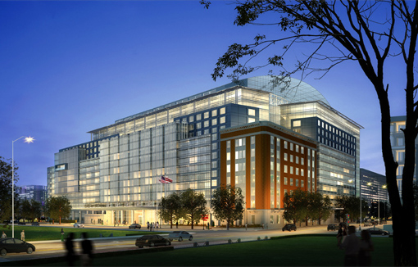
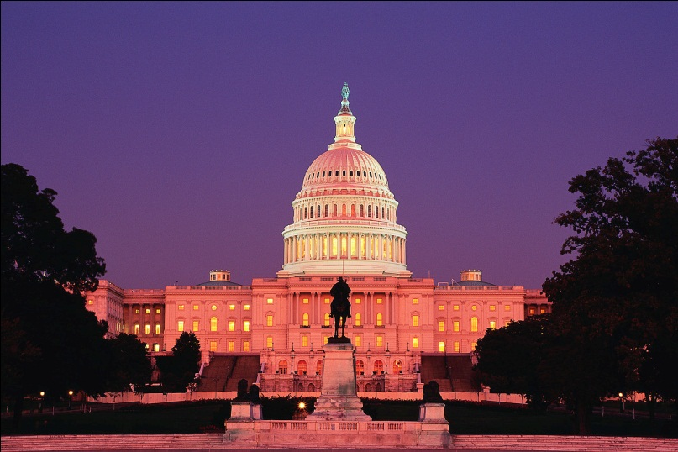
Grand Finale Summit
September 24-26, 2015
Washington DC Marriot Marquis
Please indicate interest in being a member of the Planning Committee for this meeting on the electronic evaluation.
Notes:
Pat continues

Slide 3
NCIN Graduates
Graduation cords
Photos
Exit survey for all scholars

Slide 4
Session Materials
Power points approved for posting will be available on the NCIN website.
Podcasts will be available on the web site as well.
We will email all attendees with updates on postings, please take the time to download these items and share with your colleagues.

Slide 5
Closing meeting details
Shuttles leaves every 20 min. from the lobby.
The meeting evaluation is completed online. Using the worksheet found in your meeting packet as a reminder if needed.
Contact hours and a CE certificate are available after completing this online evaluation.
Posters have been mailed directly to the lead author from the meeting site.
Expense forms can be completed electronically, review the green form in you packages for FAQs.
Post meeting emails will be sent to all attendees.

Slide 6
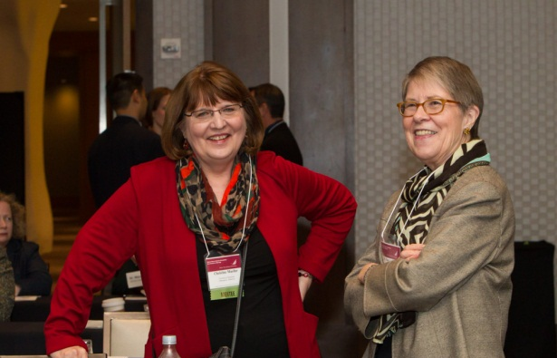
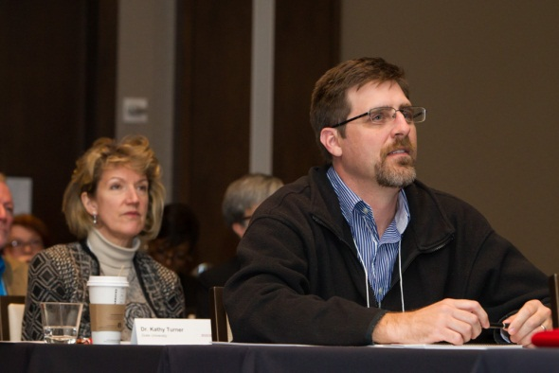
Thank you!
Thank you all for making the meeting possible.
Safe travels home!
We hope to see you all in DC in September.

Slide 7
Talk to you soon!
As always, please reach out to us with questions!

