Slide 1
Sustainability Strategies in Accelerated Programs
2013 Summit, New Careers in Nursing
October 11, 2013
Cheryl L. Brandt, PhD, RN, ACNS-BC
Lisa, 2010 ASBSN graduate

Slide 2
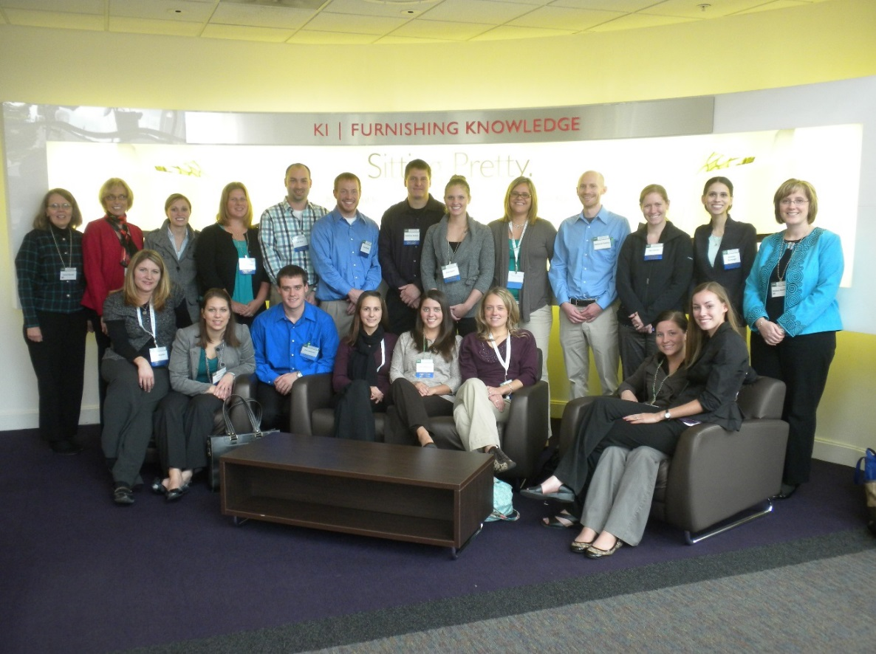
Context of This Presentation
Experience as an ASBSN faculty member and program coordinator
The literature on ASBSN education
ASBSN class of 2012

Slide 3
Resources That Must Be Sustained
Human resources
Students
Recruitment of qualified students (Fang, Bednash, & DeWitty, 2012; Sharp & Sharp, 2012)
Faculty
Faculty shortage (Rideout, 2012)

Slide 4
Administrators and administrative support staff
Importance of a leadership vision (Zhan, Finch, Lee, & Dapremont, 2012)
Clinical sites and staff
Settings for ongoing clinical placements (Caldwell & LaRocco, 2012)
Welcoming to students
Effective nurse role models
Future employers of the ASBSN graduates

Slide 5
Fiscal resources
Start-up expenses (e.g., curriculum development, program accreditation, student recruitment) (Lindsey, 2009)
Ongoing expenses (e.g., faculty and support staff salary/benefits, office and lab equipment and supplies, testing, evaluation, and much more) (Caldwell & LaRocco, 2012)

Slide 6
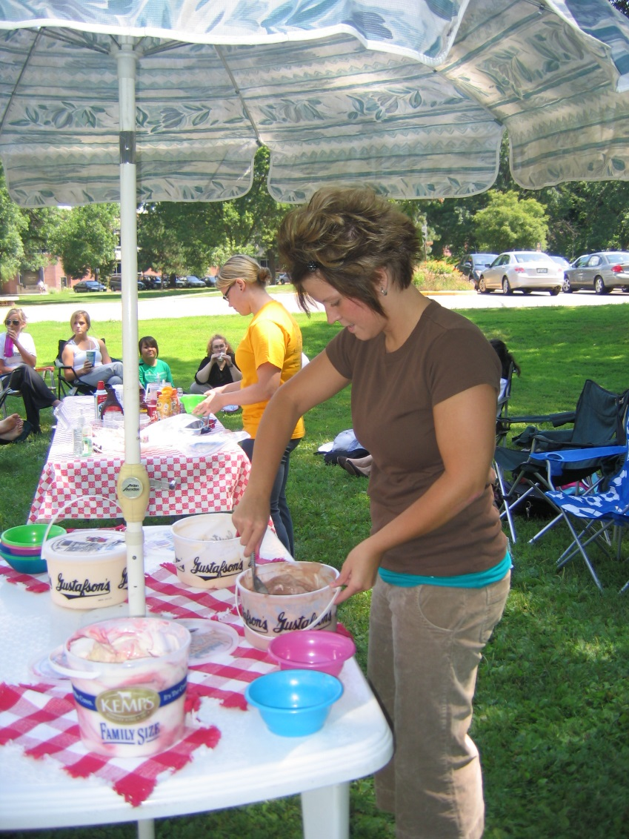
Suspending Admissions – One ASBSN Program’s Story
Christin & Caitlin, 2011 ASBSN graduates
ASBSN class of 2010

Slide 7
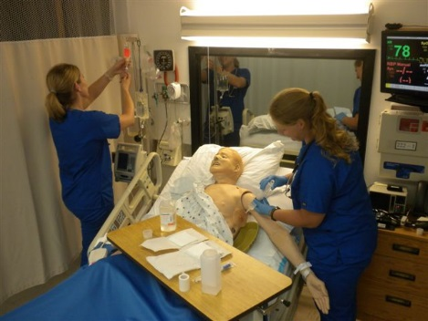
Strategies for Sustainability
Students
Sensitivity to adult learners (Sharp & Sharp, 2012)
Financial support (e.g., scholarships)
Academic support (Sharp & Sharp, 2012)
Faculty
Sensitive scheduling (Lindsey, 2009)
Seasoned instructors
Sarah & Lydia, 2012 ASBSN graduates

Slide 8
Curriculum and pedagogy
“Accelerated, not abbreviated” (Meyer, Hoover, & Maposa, 2006)
Careful scheduling
Attention to scheduling for multiple programs (Caldwell & LaRocco, 2012)
Classroom innovation (Kaddoura, Williams, & Jabaley, 2012)
Experiential, interactive learning strategies
Technology-rich classroom

Slide 9
Course delivery models
Hybrid and online (Allen, VanDyke, & Armstrong, 2010)
Clinical teaching models – ASBSN and traditional nursing education
Simulation-rich (Patillo, Hewett, McCarthy, & Molinari, 2010)
Clinical immersion (Kaddoura, Jabeley, & Williams, 2012)
Clinical teaching fellows (Mannix, Faga, Beale, & Jackson, 2006)

Slide 10
Strategic partnerships
Academic-clinical partnerships in ASBSN (Allen, et al., 2010)
Academic-clinical partnerships from nursing education in general (Mannix, et al., 2006; Murray & James, 2012)
Funding
Grant support for initial funding (Stuenkel, Nelson, Malloy, & Cohen, 2011)
Scholarship support
Cost-recovery tuition model

Slide 11
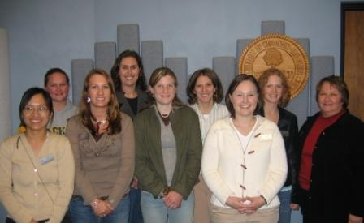
Concluding Thought
Sheryl Sandberg, Lean In: Women, Work, and the Will to Lead (2013)
Instead of “perfection” … “sustainability and fulfillment”
ASBSN Class of 2007

Slide 12
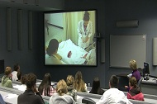
Discussion
ASBSN class of 2011

Slide 13
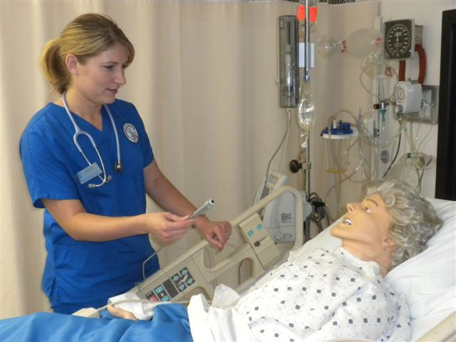
Discussion Questions – Strategy- & Solution-Focused
What questions would you like to raise?
How have educators managed/addressed key barriers to ASBSN program sustainability?
Sarah, 2012 ASBSN graduate

Slide 14
Discussion Questions - Strategy-Focused
In light of human and fiscal constraints, what is the best balance among programs a college/university might offer (e.g., traditional BSN, ASBSN, RN to BSN)?
How might ASBSN alumni, along with their nurse administrator colleagues, support ASBSN programs?
Amanda & Barbie, 2011 ASBSN grads

