Slide 1
Florida Action Coalition:
Investing in the Future of Nursing
Mary Lou Brunell, MSN, RN
Executive Director, FL Center for Nursing
Co-Leader, FL Action Coalition
www.FLCenterForNursing.org
MaryLou.Brunell@ucf.edu

Slide 2
Preliminary
Florida Action Coalition
Preliminary
Steering Committee
BCBSFF & FCN Leadership
WORK GROUPS
CORE CONCEPTS
Scope of Practice Barriers
Collaborative Effort Leadership
Nurse Residency Programs
80% Baccalaureate by 2020
R E G I O N A L I S S U E S
D I V E R S I T Y
Double Nurse Doctorates by 2020
Lifelong Learning Engagement
Leadership Development
Health Workforce Data Infrastructure
Outcomes Achieved through State & Regional Level Activities

Slide 3
Where do we begin?
Start with what we know
Find out what we don’t know
Set a course of action

Slide 4
Recommendation 1.
Practice to the full extent of
education and training.
1975 – ARNP Practice in FL Established
Must submit a physician protocol
Have limited prescriptive authority

Slide 5
Recommendation 3.
Support nurses’ completion of a transition-to-practice program (nurse residency) after they have completed a prelicensure or advanced practice degree program or when they are transitioning into new clinical areas.
2008 to 2010 FL gained 27,668 RNs
But FL lost 16,172 RNs
Resulting in net gain of 11,512 RNs

Slide 6
Recommendation 4.
Increase the proportion of nurses with a baccalaureate degree from
50 to 80 percent by 2020.
Florida’s Education Mix (potential nurse workforce)
  55.8 Associate/Diploma
  36.1 Baccalaureate (29.5% in nursing)
  7.3 Master’s (3.3% in nursing)
  0.8 Doctorate (0.1% in nursing)
To achieve 80% BSN & Higher by 2020 →
must advance degrees of 129,307
Note: Exclude ARNPs
Note: 47% in US

Slide 7
Recommendation 5.
Double the number of nurses
with a doctorate by 2020.
13% of RNs in US hold Masters or higher
In Florida – 0.8% of RNs / 4.1% of ARNPs have earned a doctorate degree (in any field)

Slide 8
Recommendation 8.
Lead a collaborative effort to improve research and the collection and
analysis of data on
health care workforce requirements.
Florida Center for Nursing – unfunded state mandate
Forum of State Nursing Workforce Centers

Slide 9
Recommendations 2, 6, and 7:
Unknowns for us at present. Much can be recalled anecdotally, but not affirmed.
Conducting a state inventory of assets
to identify those who are interested in being a part of the process and
to assess where Florida is in relationship to each of the recommendations set forth in the IOM Report.

Slide 10
SHIRLEY GIBSON, MSHA, RN, FACHE
PRESIDENT, VIRGINIA NURSES ASSOCIATION
VA Regional Action Coalition CO-LEAD

Slide 11
Virginia’s RAC Application
Submitted February 2011 - input from more than sixty stakeholders
Awarded designation in March 2011
RWJ Foundation and AARP Center to Champion Nursing in America
Focuses on technical support and exchange of best practices
Catalyst to convene diverse stakeholder around common
themes

Slide 12
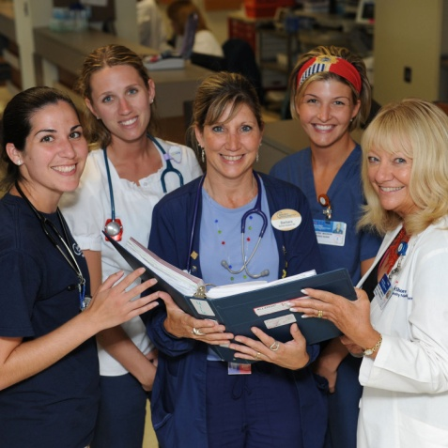
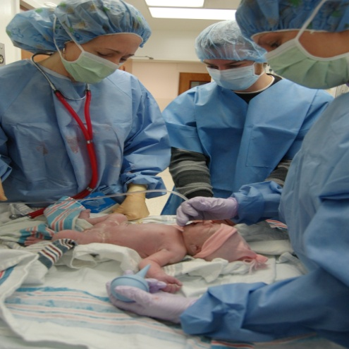
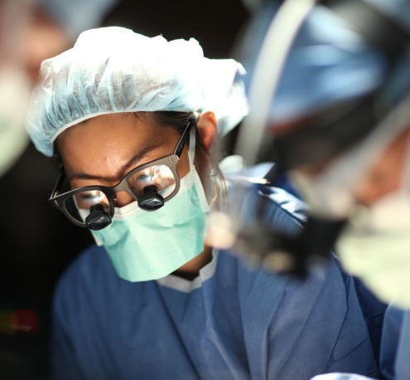
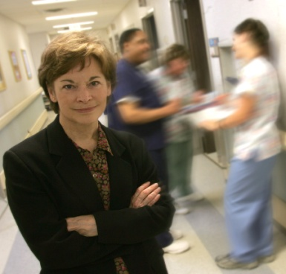

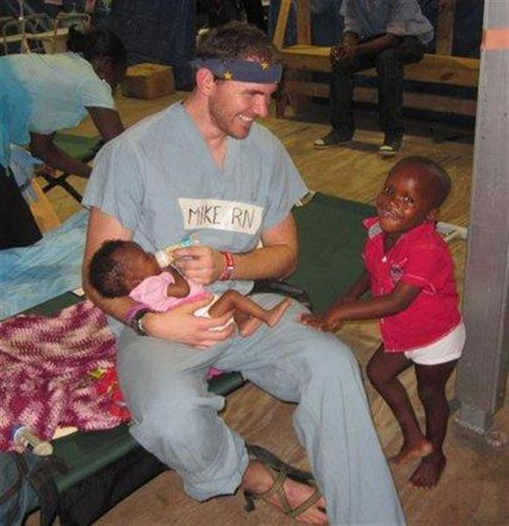
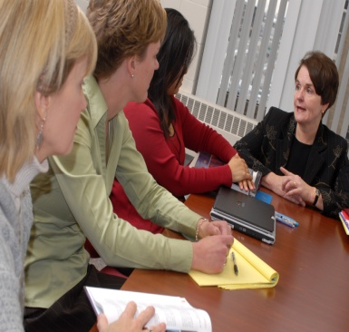
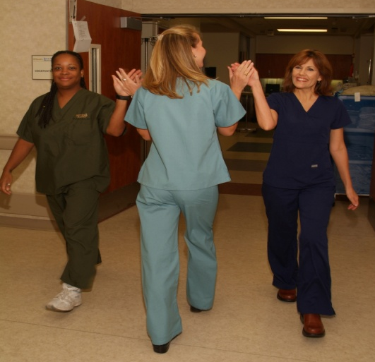
Campaign for Action:
Key Messages
Education
Leadership
High-quality patient centered
care
Interprofessional Collaboration
Access to Care
Workforce Data
Notes:
The Campaign for Action picks up on many of the themes featured in the IOM report with the ultimate goal of improving patient care. Its initial objectives are to:
Advance interprofessional collaboration across the health spectrum;
Strengthen nurse education and training to ensure an adequate supply of highly competent and professional nurses;
Expand leadership ranks to ensure that nurses have a voice on management teams, in boardrooms and during policy debates;
Enable all health professionals to practice to the full extent of their education and training; and
Improve workforce data collection.
The Campaign for Action picks up on many of the themes featured in the IOM report with the ultimate goal of improving patient care. Its initial objectives are to:
Advance interprofessional collaboration across the health spectrum;
Strengthen nurse education and training to ensure an adequate supply of highly competent and professional nurses;
Expand leadership ranks to ensure that nurses have a voice on management teams, in boardrooms and during policy debates;
Enable all health professionals to practice to the full extent of their education and training; and
Improve workforce data collection.
The Campaign for Action picks up on many of the themes featured in the IOM report with the ultimate goal of improving patient care. Its initial objectives are to:
Advance interprofessional collaboration across the health spectrum;
Strengthen nurse education and training to ensure an adequate supply of highly competent and professional nurses;
Expand leadership ranks to ensure that nurses have a voice on management teams, in boardrooms and during policy debates;
Enable all health professionals to practice to the full extent of their education and training; and
Improve workforce data collection.
The Campaign for Action picks up on many of the themes featured in the IOM report with the ultimate goal of improving patient care. Its initial objectives are to:
Advance interprofessional collaboration across the health spectrum;
Strengthen nurse education and training to ensure an adequate supply of highly competent and professional nurses;
Expand leadership ranks to ensure that nurses have a voice on management teams, in boardrooms and during policy debates;
Enable all health professionals to practice to the full extent of their education and training; and
Improve workforce data collection.

Slide 13
VA Regional Action Coalition Goals
Nurses should practice to the full extent of their education and training
Nurses should achieve higher levels of education and training through an improved educational system that promotes academic progress and explore residency programs
Nurses should be full partners, with all members of the healthcare team in redesigning healthcare
Develop strategies to ensure nursing is skilled to provide leadership at all levels
Effective workforce planning and policy making require better data collection and an improved information infrastructure

Slide 14
VA RAC Leadership Council
AARP and VNA co-leads
  Shirley Gibson
  David Debiasi
  Bill Kalio
  Susan Motley
Access to Care
  Cindy Fagan
  Linda Ault
Education Progression
  Deb Zimmermann
  Linda Dedo
Notes:
Consider having them stand
Workgroups have formed and many have had one plenary call to review goals and objectives, make modifications, and determine gaps in representation on their workgroups. If you have not been contacted and/or would like to participate, don’t worry! There is still plenty of time to get involved in a workgroup

Slide 15
VA RAC Leadership Council (con’t)
Leadership
  Loressa Cole
  Lindsey Cardwell
Workforce Planning
  Richardean Benjamin
  Nina Beaman
Team Based Care Delivery
  Sallie Eissler
  Patti McCue
Notes:
Workgroups have formed and many have had one plenary call to review goals and objectives, make modifications, and determine gaps in representation on their workgroups. If you have not been contacted and/or would like to participate, don’t worry! There is still plenty of time to get involved in a workgroup

Slide 16
What Does this Mean for Nursing in Virginia?
Partners:
  Virginia Nurses Association
  AARP Virginia
Existing work:
  ANA
  All nursing organizations, education, employers, regulatory
Allied partners:
  All stakeholder groups
Notes:
Synergy between IOM IFN Report and work of groups already underway (I can drop in logos)

Slide 17
Goals
VA Regional Action Coalition
Access
  Practice to the full scope of practice
  Advance Practice Registered Nurses
  All nurses
Education
  Academic progression
  Residency programs

Slide 18
VA Regional Action Coalition Goals
  Leadership
    Nurse Leaders at the Bedside
    Nurse Leaders on Boards
  Workforce Planning
    VDH/Workforce Development Authority
    DHP’s Healthcare Workforce Data Center
  Team based care delivery
    VHRI
    Interprofessional Education

Slide 19
Key Messages Dovetail with Virginia’s Work
ACCESS
  Virginia Council of Nurse Practitioners –MSV
  Department of Health Professions
  AARP
EDUCATION
  Virginia Magnet Consortium
  Richmond Memorial Health Foundation PIN 6 Grant
LEADERSHIP
  Center to Champion Nursing in America– Nurses on Boards
  Richmond Memorial Health Foundation - Nurse Leadership Institute

Slide 20
Key Messages Dovetail with Virginia’s Work
WORKFORCE PLANNING
  Department of Health Professions Workforce Data Center
  Department of Health Workforce Development Authority
TEAM BASED CARE DELIVERY
  VHRI
  UVA Macy Grant
Many more

Slide 21
Greater Need to Know Now
Driving forces for a “perfect storm:” Unprecedented demand increase with supply decrease.
By 2020, Virginia is estimated to have 1 million more people than in 2008 and a greater proportion age 65+.
A large portion of Virginia’s nurses are “Baby Boomers” and older, and the trend is expected to continue into the next decade.
Insurance coverage through the Patient Protection and Affordable Care Act should add to the demand at the same time that a large bulk of practitioners will want to reduce hours or retire.

Slide 22
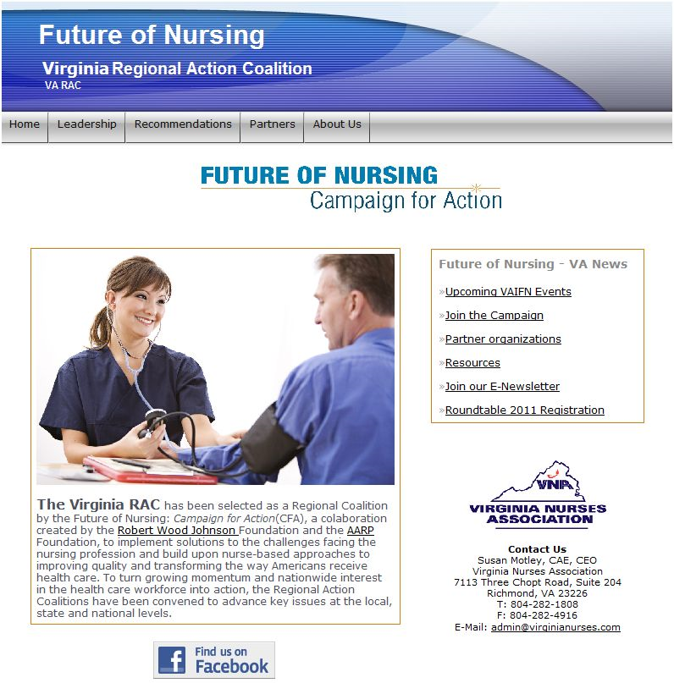
Engage!
Sign up for VA Regional
Action Coalition at
www.vaifn.org
E-newsletter!
Notes:
Point them to www.vaifn.org

Slide 23
Upcoming Events and Opportunities
Forty under Forty deadline July 15
Deans and Directors meeting August 11 (tentative)
Virginia Nurses Association Education day 9/24
  Linda Burnes Bolton
  Tina Brashers
  Diana Mason
Virginia Nurses Foundation Gala 9/24
Support the Virginia Nurses Foundation work of the VA Regional Action Coalition
Engagement of the broader community
Notes:
Many of you have already nominated a deserving nurse and in order to accept as many as possible the nominations have been extended to July 15. please go to www.virginianurses.com to nominate a deserving future leader
We are also convening a meeting of the deans and directors of the schools of nursing in Virginia. A tentative date has been selected and as soon as we firm up the meeting space you will be getting your invitation.
Linda Burns Bolton Vice President and Chief Nursing Officer, Cedars-Sinai Medical Center, vice chair, RWJF Initiative on the Future of Nursing at the IOM.
Tina Brashers,
Dianna Mason Diana J. Mason, PhD, RN, FAAN, is the Rudin Professor and Director at the Center for Health, Media, and Policy, Hunter-Bellevue School of Nursing, Hunter College, City University of New York

Slide 24
California’s Regional Action Coalition
Initiative on the Future of Nursing
Linda Hansen-Kyle, PhD, RN, CCM
Azusa Pacific University

Slide 25
California Action Coalition
-Recommendations from the IOM/RWJF Initiative on the Future of Nursing (IFN) provides framework for California to rally key and diverse stakeholders to realize nursing’s contribution to the health of our communities.
-This framework will enhance the state’s ability to provide care to the people of California that is accessible, affordable, and improves health outcomes and links to current efforts underway implementing health care reform changes.

Slide 26
California Action Coalition
California was selected as one of five states to pilot the implementation of the recommendations.
Effort is being led by the California Regional Action Coalition (RAC), with an opportunity for all stakeholders and interested persons to participate.
A leadership council with representatives of key stakeholder groups provides oversight of the IFN in California.
Workgroups for each recommendation will be established to set short and long-term goals.
Regional champions will ensure that all regions of the state are represented on work groups and linked to the statewide efforts.

Slide 27
Charge of California Coalition’s
Engage a diverse group of stakeholders to develop a blue print for implementation of the recommendations.
Develop state-prioritized recommendations to maximize the capacity of the California nursing workforce to meet the demands of our evolving health care system that is responsive to the needs and priorities of the populations we serve.
Promote changes throughout healthcare delivery systems that emulate the state-specific recommendations for IFN implementation.
Provide leadership in changes to public and institutional policies at the local, state and national levels that draw on nurses’ expertise to improve the health of communities.

Slide 28
Charges cont…
Build visibility and engagement of the IFN with the community at large.
Develop a strategic plan for securing funding and on-going support of the implementation of the California RAC recommendations.
**Implementation of the recommendations will build upon work and infrastructures that already exist in California; results of years of collaborative and partnership efforts that have addressed the state’s nursing education and workforce priorities.

Slide 29
Collaborative Partners
Physicians
Employers
Policy makers
Funders
Consumers
State agencies
Educators
Nurses

Slide 30
Programs Underway
Collaborative model of nursing education
Implementation of AB1295
Transition to Practice Program
Passage of state legislation authorizing
CSUs to provide a doctorate of nursing practice education

Slide 31
Executive Team for the California RAC
(as designated by RWJF):
Juan Arambula - former State Assemblyman – co-lead
Mary Dickow – UCSF, Director of RWJF Executive Nurse Leaders Fellows
Deloras Jones – California Institute for Nursing & Health Care – co-lead
Stephanie Leach – Kaiser Permanente, California Team Leader to the Center to Champion Nursing in America (under AARP)
Gloria McNeal – Charles Drew University School of Nursing
Ed O’Neil – UCSF, Center for Health Professions
Marybeth Sharpe –Gordon & Betty Moore Foundation
Heather Young – UC Davis, Betty Irene Moore School of Nursing

Slide 32
Future of Nursing-
New York State Initiative
Kathy Lucke, PhD, RN
University at Buffalo
School of Nursing

Slide 33
Leadership - NY
Co-leaders from Future of Nursing NY Steering Committee
  Cathryn A. Welch, EdD, RN, Executive Director of the Foundation of New York State Nurse and Director, Institute for Nursing
  Robert O’Connell, MSW, AARP Executive Council
IOM recommendations subcommittee
Regional champions

Slide 34
NY Priorities
Scope of Practice
Increase BSN
Increase Doctorates
Workforce Data

Slide 35
Additional Recommendations
Nurse Residency
Lifelong Learning
Leading Healthcare Change
Collaborative Improvement Efforts

Slide 36
NYS Task force to Double Number of Doctorates in Nursing
Strategic Plan: Year 1 Goal--Data collection and Recruitment Strategies
    Convene subcommittee
    Develop baseline data
    Develop strategies to increase the number of doctoral students
    Develop strategies to recruit more applicants to doctoral programs earlier in their career
    Expand current resources available to allow students to attend school full-time
    Develop pilot project to increase recruitment efforts

Slide 37
NYS Task force to Double Number of Doctorates in Nursing
Strategic plan: Year 2 Goal – Ensure programs have infrastructure to augment current doctoral programs
  Assess faculty development initiatives with focus on teaching
  Develop strategies to assess education/teaching content in doctoral programs
  Develop pilot project to enhance education/teaching content in faculty development programming and curriculum for current and incoming students
  Implement recruitment plan

Slide 38
NYS Task force to Double Number of Doctorates in Nursing
Strategic Plan: Year 3 Goal – Implementation
  Continue evaluation of recruitment plan; expand activities
  Implement pilot project
  Institute ongoing evaluation plan
  Seek on-going funding

Slide 39
